Slide 1


AEM- Raid Deployment Workshop
11.12.2024 – 12.12.2024

Slide 2
Prerequisites Bootcamp
SAP Advanced Event Mesh
SAP Cloud Foundry Runtime with Quota
SAP IAS
SAP S/4HANA Cloud or SAP S/4HANA 2023 or SAP S/4HANA 2022 ( incl. Patch)
SAP RAP /Eclipse (ABAP Development Tools)
SAP Integration Suite
SAP Process Automation
Roadmap: SAP CALM
SAP ECC with Application Interface Framework

Slide 3
Bootcamp Agenda
Topic 1 (Basic) | Topic 2 (S/4HANA) | Topic 3 (Enhanced Integration) | Topic 4 (Operations) | Topic 5 (AIF)
When to use which SAP Broker? Events in context of S/4HANA Starting of AEM instances and Mesh Creation Simulator | Connect S/4HANA to SAP AEM Configure Standard Event Configure RAP Events | Connect AEM to SAP Integration Suite Connect AEM to SAP Process Automation | Event Management Event Portal Approval Event Insights Monitoring Distributed Tracing AEM APIs | ECC Usage with AIF

Slide 4




SAP TEAM
Alex Pfeil
Erik Heinrich
Timo Maier
Nils Lorenz

Slide 5



The World is Real Time – Use Cases What is your Motivation and Use Case?
Maintenance teams need to know of breakdown as soon as possible
Inventories must be updated as soon as sales happen
Passengers want to be informed of gate changes and delays

Slide 6
Event sources and consumers – standard SAP and custom add-ons for events Big Picture
SAP ERP
Custom Only
Custom events only using the event enablement add-on
Ability to include notification events and data events
Allowance for inbound and outbound events
CloudEvents format
SAP S/4HANA Cloud
Standard and Custom
Approximately 600 standard notification events documented on Business Accelerator Hub
Events based on the ABAP RESTful application programming model
Adjustable and extensible standard events
Custom notification and data events
Inbound and outbound
SAP S/4HANA
Standard and Custom
Approximately 600 standard notification events documented on Business Accelerator Hub
Events based on the ABAP RESTful application programming model
Adjustable and extensible standard events
Custom notification and data events
Inbound and outbound
Custom add-on events
SAP SuccessFactors solutions
Standard
Reuse of Intelligent service events
Adjustable standard events
Both notification and data events
No support for custom events
Support for JSON and SOAP formats, CloudEvents format planned for future releases
AIFAEM
Add-on
AIFAEM
SAP Integration Suite
SAP Integration Suite, advanced event mesh
SAP Event Mesh
Add-on
AIFAEM
Notes:
1:30min
11:30-13:00
I want to double click on standard events in our applications for a minute, particular S/4.
We have already published about 600 standard events in S4/H Cloud on private and on prem.
We have native eventing support in RAP - and you now can define your derived events and payload events with full extensibility based on standard events in RAP.
As with APIs, we are listening to our customers to continouusly enhance the set of standarrd events.
For older ERP releases, partiuclar on prem, we are working with a partner to support custom defined events and connect to the Mesh easily.

Slide 7
High-level comparison – SAP Event Mesh and advanced event mesh
 | SAP Event Mesh | Advanced event mesh
Recommended for | SAP’s event-driven ecosystem and third-party components around the ecosystem | General purpose including SAP ecosystem
Target scenarios | SAP to everything | SAP to everything and everything to everything
Main use cases | Integration and extension | Integration, event streaming, and event-driven backbone
Numbers | Message size up to 1 MB 10 GB of storage Guaranteed throughput of 250 KBps | Message size up to 30 MB Storage up to 6 TB Up to billions of events per day
Interfaces | REST, JMS, AMQP, MQTT over WebSockets | REST, JMS, AMQP, MQTT, SMF over WebSockets and direct
Deployment | On SAP BTP | Almost anywhere including cloud and on premise
Pricing | Usage-based pricing, starting with zero cost | Various T-shirt sizes, grows with your business
Advanced features | Facilitated connectivity to selected SAP software back ends Integration into SAP services and solutions | Opening on payloads Support of transactions Support of replay of events Distributed tracing support

Slide 8
Comparison RAP based, AIF, and Add-On based event enablement When to use what?
Criteria | RAP based | AIF | EE Add-On
Target Scenario | Standard SAP / Go To Approach for SAP S/4HANA environments 2022+ | Good choice for older backends specifically for existing AIF customers | Great choice for older backends, specifically with No Code / Low Code approach
Event Type | Extensible Standard and Custom Events | Custom Events (data and notification) | Custom Events (data and notification)
Event Trigger | RAP BOs | BOR Objects Idocs BAPIs/RFC | BOR Objects IDocs BAPIs/RFC
Commercials | Free usage with EM, EMIS and AEM | Free usage with AEM | Included with EM and EMIS Partner Add-On (ASAPIO) for AEM
Supported Backends | SAP S/4HANA (2022 and 2023) SAP S/4HANA Cloud | SAP ECC SAP S/4HANA SAP S/4HANA Cloud | SAP ECC SAP S/4HANA
Delivery | Included in SAP S/4HANA | Included in SAP S/4HANA Add-on for ECC | Add-On for SAP ECC and SAP S/4HANA
Supported Brokers | SAP Event Mesh Event Mesh in Integration Suite Advanced Event Mesh | Advanced Event Mesh | SAP Event Mesh (Advanced Event Mesh – via paid partner version)
Highlights | 500+ ready to use standard events Very high scale out Standard RAP Framework approach A lof of sophisticated features | Huge installed AIF base Great Monitoring Support Commercials | Great time to event Strong Low Code / No Code Different event creation technologies Goes back to very old backends
Topic 2
Topic 5

Slide 9
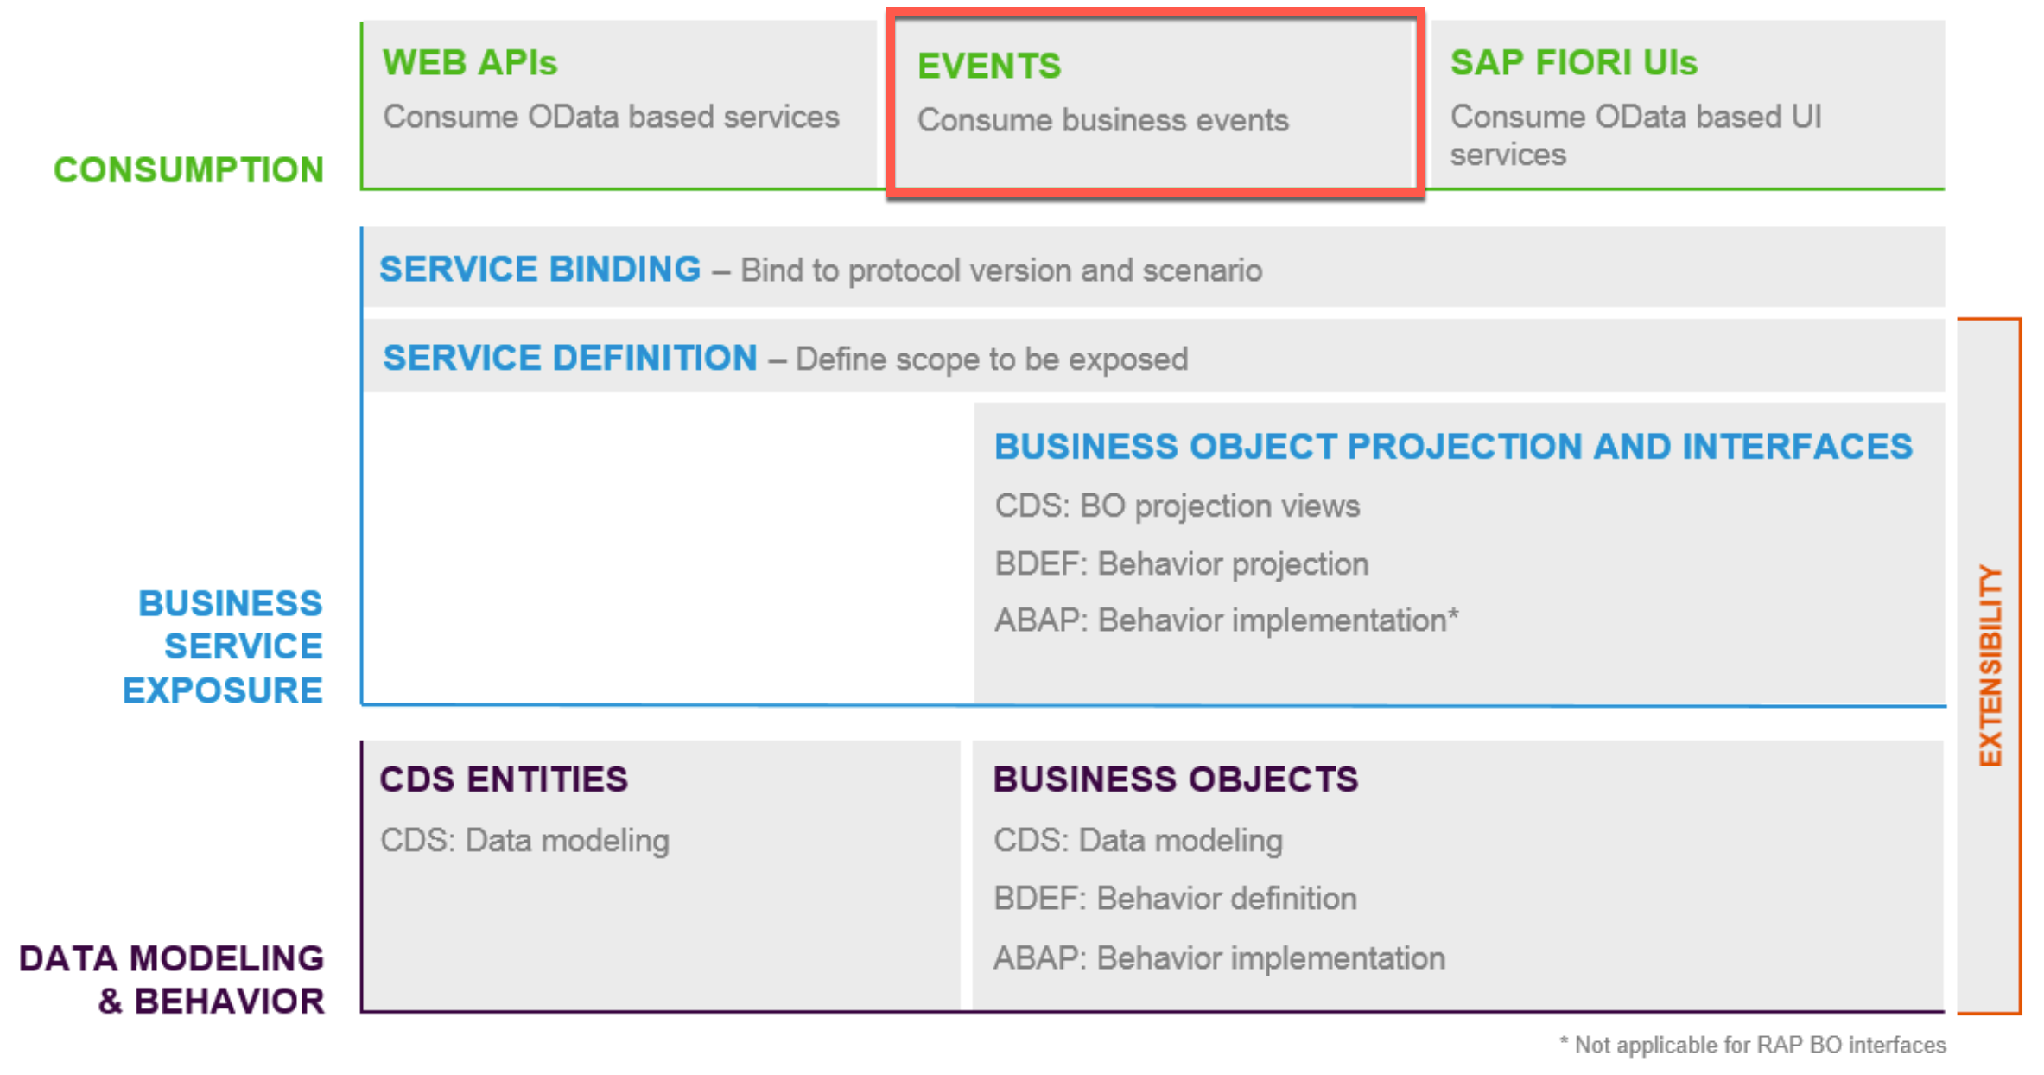
S/4HANA Event Enablement : Highlights and Selected Features
SAP standard approach fully in line with Clean Core initiative and highly scalable
Natively integrated RAP solution, inheriting all RAP qualities: extensibility, documentability, supportability and testability.
Builds on standard RAP based, SAP provided events in CloudEvents format
Easy enhancements and extension of standard events (e.g. context attributes, additional payload, removal of payload)
Provides performance optimization features (e.g. source side filtering, local event handling)
Allows for creation of custom events based on RAP approach and concepts
Allows for Outbound and Inbound Events

Slide 10
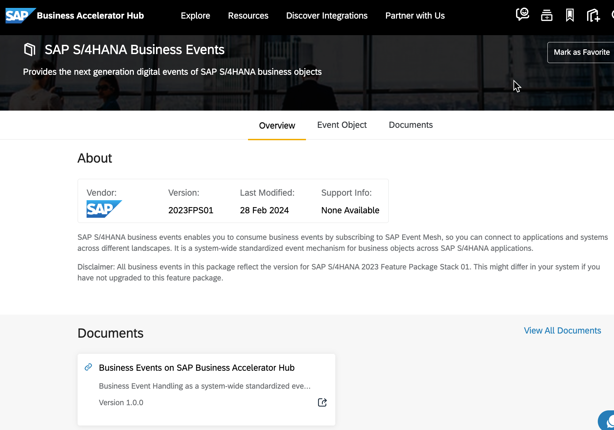
SAP S/4HANA Business Events Where to find?
SAP S/4HANA business events enable consumption of business events from SAP S/4HANA.
Business Events are a standardized event mechanism for business objects across SAP S/4HANA applications.
Available standard SAP S/4HANA Business Events can be looked up on the SAP Business Accelerator Hub.
Currently there are about 600+ standard business events for SAP S/4HANA.
Most of these events can be adjusted and extended.
Custom events can be created if needed.

Slide 11
S/4HANA Feature Readiness and Service Packs? Am I ready?
Feature | Feature Description | OnPrem Release | Cloud Release | Remarks
BEH GA | CloudEvents 1.0, can be used in production | 2020
EEEC/Inbound with XBE | Generating event consumption classes for customers to consume inbound events | 2022 | 2208
AMQP | Support of AMQP protocol (mostly needed for inbound events) | 2021, 2020 SP05 | 2108 | SAP Note 3145443
RAP | initial RAP scope, half of events migrated, customers can create own events | 2022 | 2208
RAP Extensibility | Derived Events, custom-defined context attributes for filtering & dynamic topics | 2023 | 2308
Local Events | Local event handling in RAP | 2023 | 2308
Filtering | Outbound Filtering based on annotation | 2023 | 2402 | SAP Note 3343266
AEM | Support of AEM | 2023; 2022 SP04 | 2402 | SAP Note 3464607
Dynamic Topics | Dynamic topic segments, e.g., sap/s4/custom/CustomBusinessObject/Created/v1/{Custom Context Attribute 1}/{Custom Context Attribute 2}. | 2023SP02 | 2408 | Note 3464972
Event Broker (kernel service) |  | PCE only | 2308
Dead Letter Queue | Failed events are never deleted | 2023 SP02, 2022 SP04, 2025 |  | SAP Note 3145443

Slide 12

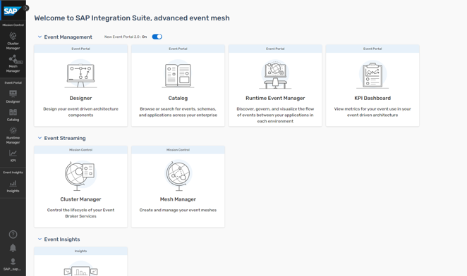
SAP Integration Suite, advanced event mesh
Day 4
Customer Experience
Factories anywhere
Advanced event mesh
Event streaming
Real-time routing of filtered events across geographically distributed, heterogenous landscapes
Event management
Design • Catalog • Discovery • Monitor
SAP Cloud solutions and on-premises applications
Azure, AWS, GCP
Managing and processing events at enterprise scale

Slide 13

SAP Integration Suite, advanced event mesh: Details
 | SAP Integration Suite, advanced event mesh
Fully managed cloud service | ✓
Infrastructure model | Exclusive in T-Shirt Sizes
Deployment options | Private and Public Clouds
Connecting SAP and non-SAP systems | ✓
Out-of-the-box support for SAP event sources | ✓
Support of standard protocols | ✓
Message size and storage | Up to 30MB / Up to 6TB
Typical use case size | Small to Ultra Large
Network of event brokers | ✓
Advanced event monitoring and analysis | ✓
Dynamic event routing | ✓
Filtering | ✓
Event replay | ✓
Event management | ✓
Distributed Tracing | ✓

Slide 14
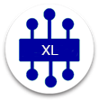
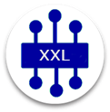





Broker T-Shirts Sizes
 | Developer | Enterprise Services | Enterprise Services
T-Shirt Sizes | XXS | XS | S | M | L | XL | XXL
Availability Configuration | Single node (no HA) | High-Availability (always deployed as a group providing fast, automatic HA-failover) | HA Group |  | HA Group |  | HA Group
Scaling Tier ¹⁾ | 100 | 250 | 1K | 5K | 10K | 50K | 100K
Maximum Concurrent Active/Open Connections | 100 | Up to 250 | Up to 1000 | Up to 5K | Up to 10K | Up to 50K | Up to 100K
Maximum Queues | 100 | 250 | 1000 | 5K | 10K | 50K | 100K
Cores In Use | 2 | 4 |  | 8 |  | 16
Maximum Throughput (Mbps) | 8 | 450 | 450 | 750 | 750 | 1,000 | 1,000
Default Storage (GB) | 2 | 25 |  | 50 | 200 | 300 | 500
Maximum Storage (GB) | 2 | Configurable up to 800GB (6TB coming) ²⁾ | Configurable |  | Configurable |  | Configurable
Maximum Message Size (MB) Persistent | 10 | 10 |  | 30
Maximum Message Size (MB) Non-Persistent | 10 | 10 | 64
¹⁾ A scaling tier determines how many resources a broker pre-allocates (CPU cores, RAM etc) and this shapes various resources and their limits available to clients, like – most importantly - number of max concurrent connections and queues, but also more. See here for more details. ²⁾ See https://help.pubsub.em.services.cloud.sap/Cloud/Configure-Message-Spools.htm for details.

Slide 15
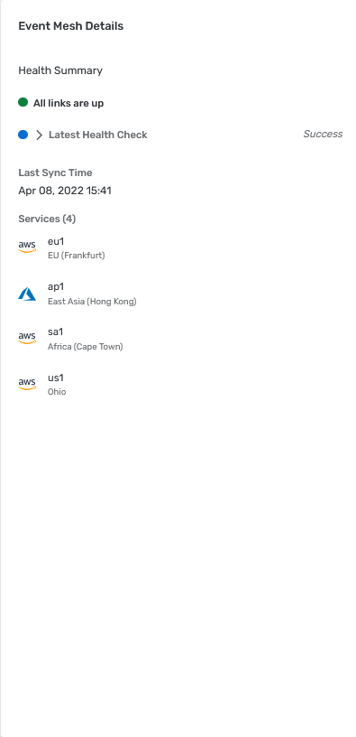
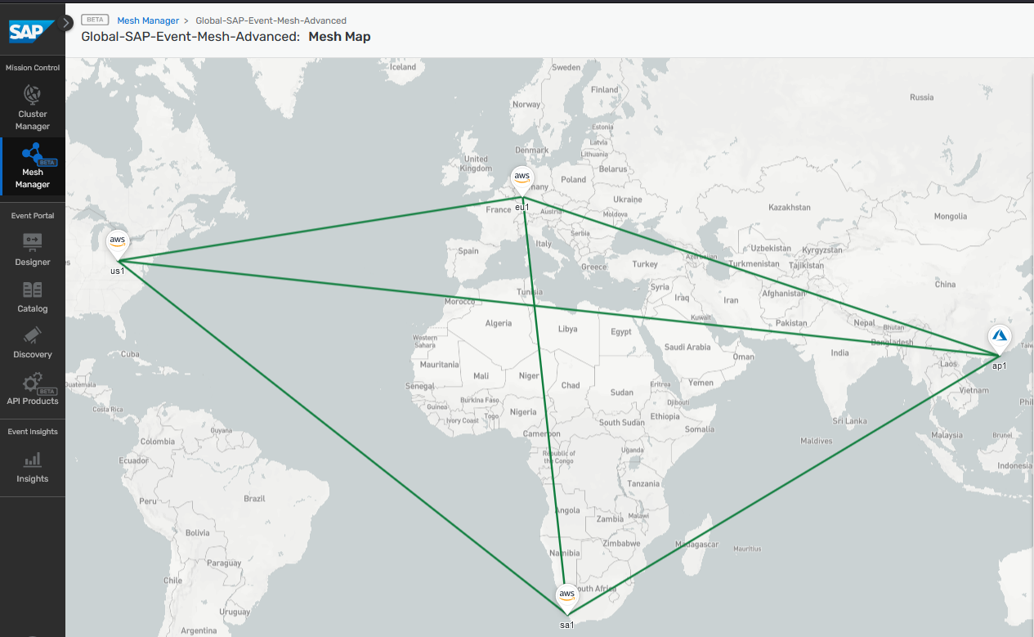
Mesh Manager for creating and managing your Mesh

Slide 16


Exercise Flow Digital Integration Hub Topic 1 1. Start Advanced Event Mesh 2. Create Message Broker and Event Mesh 3. Deploy ERP Simulator within CF Runtime ( will be provided) Create Test Events Consume via SAP AEM Tryout 4. Usage of Event Dashboard, Display/ Consume Events
Public Cloud Apps I Data I Users | Things
Desktop
SAP Business Technology Platform
SAP IAS
3
Event Simulator
1
2
Using Tryout
Advanced Event Mesh
4
SAP IAS
On-Premise Integration Components
Firewall
DMZ
Firewall
Firewall
On Premise Apps I Data I Users | Things

Slide 17



API Architecture vs. Event-Driven Architecture
API Architecture
Event-Driven Architecture (EDA)
Event Broker
API
Request and Reply Based Synchronous
Push-Based Asynchronous Decoupled

Slide 18
Event sources: Notification and data events
Data Event
Notification Event
Advantages
All needed data included in event
Good when full data set required in majority of cases
Challenges
Larger event size results in higher resource consumption for source, event broker, and consumer
Raises topics like data access and protection
Advantages
Very small
Only minimal required data set, controlled data access
Challenges
Additional synchronous step required
Suitable API needed on top of suitable event
Additional configuration for API access

Slide 19
Event sources: Custom and standard events
Day 2
Day 2
Standard Event
Custom Event
Provided by SAP business applications / back ends as part of SAP standard
Can be looked up at SAP Business Accelerator Hub (api.sap.com) or in SFSF Intelligent Services documentation
Typically notification events; can be data events too
Means to adjust/extend standard events provided by back ends and differ from back end to back end
For some back ends, no adjustments are possible
Created by customers to address use cases for which no standard events are available
Ways to create custom events differ from back end to back end
Typical tools are the event-enablement add-on or the RAP-based approach
Custom events can be completely tailored to fit specific customer needs

Slide 20
Event sources: Outbound and inbound events
Outbound Event
Inbound Event
Outbound (from a back-end perspective) means that an SAP back end is the event source
Today this is 90 percent the case
Standard outbound events enabled with just one click
Custom outbound events can be created with low-code/no-code to pro-code approaches
Inbound (from a back-end perspective) means that an SAP back end is the event consumer
Today this is 10 percent the case
Pro-code development effort needed to specify what to do when receiving an event
Calling an API is often seen as an easier alternative

Slide 21
Topic 2 - Business Events in S/4HANA
S/4HANA Business Events
Standard Content
Creating Custom Business Events
Customizing and Consuming Business Events
Derived Events
Inbound Events

Slide 22
S/4HANA Business Events based on RAP
ABAP RESTful Application Programming Model (RAP) combines concepts, tools, languages, and powerful frameworks to build cloud-ready enterprise applications. RAP offers standardized development flow based on Core Data Services (CDS), ABAP, and business services in Eclipse-based ABAP Development Tools (ADT).
2022+
Seamless integration of reuse components such as business events in the RAP framework is offered to lower total cost of development.
Developers can easily enable the exposure of business events within RAP based applications.

Slide 23


RAP-improved S/4HANA Event Enablement
SAP S/4HANA
Application
Enterprise Event Enablement
SAP * Event Mesh
RAP
Event enablement of applications leverages RAP
Events as integral part of programming model
Significant improvements in performance, robustness and administration
Custom events enabled
Infrastructure Features
Improved error handling through (enhanced) integration of Application Integration Framework (AIF)
Performance: Parallelization
Open Resource Discovery (ORD) – discoverability by (future) services
Inbound Events
 | RAP based Events
May 23 | 144
September 23 | 389
Notes:
No additional license required

Slide 24
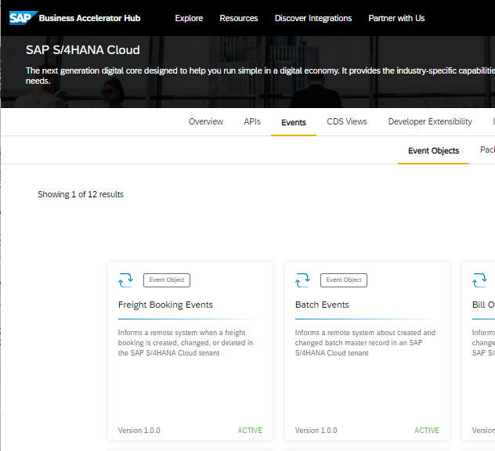
Standard Content on SAP Business Accelerator Hub
Currently (2402) released for public cloud: 139 objects with 538 events
Roughly the same content for private cloud/on premise (2023FPS1): 147 objects with 555 events
Notes:
We deliver our content on API hub, since events are also APIs in their own way. We provide the events, as well as the standard APIs, to let the customer extend our applications, not “in-app” extensibility within the ABAP stack, but externally on SAP Cloud Platform or some other extension platform of the customers’ choice.
In 2005 we have delivered 32 objects with 88 events, which is by far not enough. The events were in “Version Beta”, that is not released for productive usage.
In 2008, we plan to be Generally Available. And we will, for the most relevant standard APIs, OData-based and others, deliver accompanying events. Eventually every API has to deliver the related event. This is based on the assumption that our APIs are based – more or less – on business objects (or SAP Object Types [but it’s fair to use the term business object for SOTs]). Thus the standard events for all business objects that have an API should be provided.
Now, with development not quite finished, we have about 160 events, including those from Marketing.
All events are based on a new modeling approach that I will show later.

Slide 25
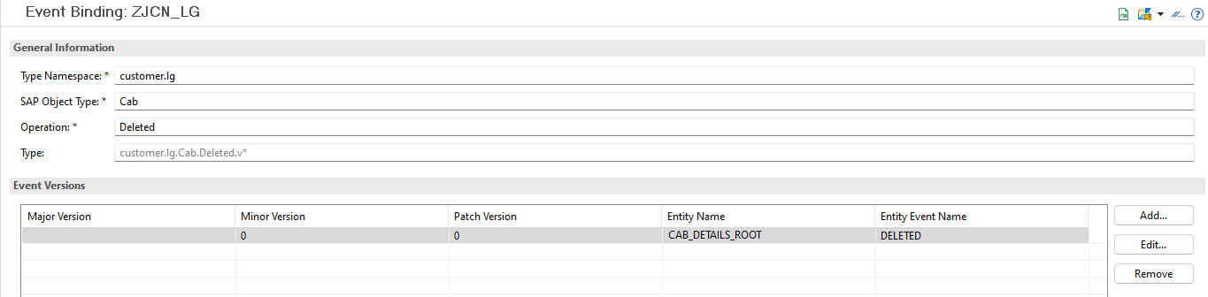
Custom Events
Abstract Entity
define abstract entity …
{
// define fields of payload:
FieldOne : sometype;
…
}
Application
Behavior Definition (BDEF)
… implementation …
define behavior for …
{
…
event deleted parameter D_…;
}
BAdI
…=>Raise…
Implementation 1
METHOD save_modified.
…
RAISE ENTITY EVENT …deleted FROM …

Slide 26

S/4HANA: New Features and Way Forward
Source-side filtering (2308)
Internal event consumption (2308)
More and better content
Notification events grow in number and in size
First data events (on demand and on CUSTOMER request)
Event extensibility
Enhancements of standard events (context attributes, remove payload; add payload)
Overall infrastructure improvements
Monitoring, tracing, performance, robustness
Continuous adoption of internal SAP event standards

Slide 27
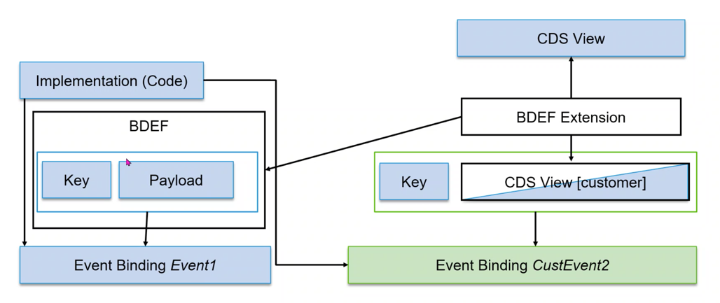

S/4HANA Business Events: Derived Events
2023
Create a Derived Event based on standard notification events
The original event remains untouched
Standard payload is replaced with a matching CDS view (key available in standard event as well)
No programming, just configuration
Internally, the notification event is used as a trigger, the configuration defines the “enrichment”

Slide 28
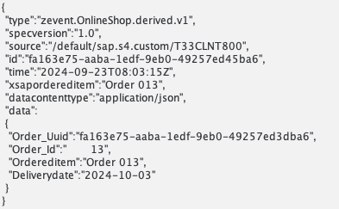
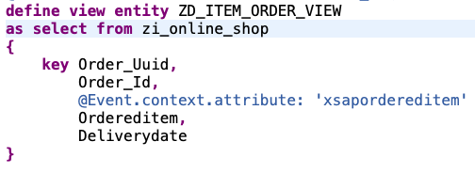
S/4HANA Business Events: Context Extensibility
2023
Add attributes from payload to context (header)
Requires an extension of the CDS view, which must be extensible (prerequisite for ABAP cloud)
Context is used for outbound filtering in S/4HANA
Context will be supported for further operations in infrastructure (routing, filtering)

Slide 29
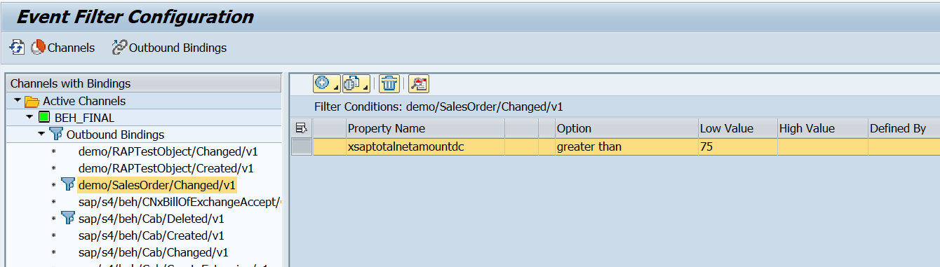
S/4HANA Business Events: Outbound Filtering
2023
Send out only events that match “filter” (on source side)
Selection screen like conditions for “filter”
Channel-based
Condition based on Context attributes
Works with derived events

Slide 30
S/4HANA Business Events: Inbound Processing
Inbound processing can be implemented using ABAP Cloud technology
Event handler (“agent”) local implementation in S/4HANA generated from event specification (AsyncAPI) -> leverage internal APIs
Based on event definition (Async API)
…
This is a sophisticated architecture pattern and its use should be carefully evaluated!
SAP S/4HANA
Application APIs
Event Handler
Enterprise Event Enablement
SAP Event *
External Producer

Slide 31
S/4HANA Business Events: Local Event Handling
2023
SAP S/4HANA
Application
Enterprise Event Enablement
SAP Event *
Consumer
RAP
Custom Event
Local Event Handling
Available from 2023/2308
Leverages all existing RAP events
Local ABAP implementation
Can be used to send “own event” based on standard event
Local Consumer (ABAP Cloud)
Local Consumer (ABAP Cloud)

Slide 32



Exercise Flow Digital Integration Hub Topic 2 1. Connect S/4HANA or S/4HANA Cloud with Standard Events Connect AEM to S/4HANA Publish Standard Events from S/4HANA to AEM 2. Connect S/4HANA or S/4HANA Cloud with Custom Events 3. Consume Events with S/4HANA or S/4HANA Cloud
Public Cloud Apps I Data I Users | Things
S/4HANA Cloud
Desktop
SAP Business Technology Platform
Event Simulator
Advanced Event Mesh
Pub / Sub
Cloud Integration
SAP IAS
3
On-Premise Integration Components
Firewall
DMZ
Firewall
Firewall
On Premise Apps I Data I Users | Things
1
2
S/4HANA

Slide 33
Appendix

Slide 34


SAP Event Mesh
Fully-managed service for enabling enterprise-grade event-driven architectures
Low entry barrier to event-driven architectures with pay per use-based pricing
Integrate and extend SAP applications in an event-driven way based on SAP Integration Suite
SAP BTP Deployment and native event broker for SAP S/4HANA, free add-on for custom ECC events
Openness and focus combined by supporting open standards and providing extra benefits for SAP ecosystem
Scales well with certain set limits
SAP Event Mesh

Slide 35

SAP Integration Suite, advanced event mesh
Fully-managed service for enabling enterprise-grade event-driven architectures
Distributed mesh of event brokers deployed across environments in private or public clouds
Enterprise-grade performance, reliability, security and governance; scales to very large use cases
Full purpose set of eventing services including event streaming, event management and monitoring
Advanced features like dynamic message routing, fine-grained filtering, distributed tracing
Power couple with SAP Integration Suite for Event Mediation and Orchestration
Advanced Event Mesh

Slide 36
Comparing SAP solutions for event-driven integration
 |  | SAP Event Mesh | SAP Integration Suite, advanced event mesh
Standard | Fully managed cloud service | ✓ | ✓
 | Infrastructure Model | Shared | Exclusive in T-Shirt Sizes
 | Deployment Options | BTP Deployment | Private and Public Clouds
 | Connecting SAP and non-SAP systems | ✓ | ✓
 | Out-of-the box support for SAP event sources | ✓ | ✓
 | Support of Standard Protocols | ✓ | ✓
 | Message size and storage | 1MB / 10GB | Up to 30MB / Up to 6TB
 | Typical use case size | Small to Medium | Small to Ultra Large
Advanced | Network of Event Brokers |  | ✓
 | Advanced Event Monitoring and Analysis |  | ✓
 | Dynamic Event Routing |  | ✓
 | Filtering |  | ✓
 | Event replay |  | ✓
 | Event Management |  | ✓
 | Distributed Tracing |  | ✓

Slide 37
High-level comparison – SAP Event Mesh and advanced event mesh
 | SAP Event Mesh | Advanced event mesh
Recommended for | SAP’s event-driven ecosystem and third-party components around the ecosystem | General purpose including SAP ecosystem
Target scenarios | SAP to everything | SAP to everything and everything to everything
Main use cases | Integration and extension | Integration, event streaming, and event-driven backbone
Numbers | Message size up to 1 MB 10 GB of storage Guaranteed throughput of 250 KBps | Message size up to 30 MB Storage up to 6 TB Up to billions of events per day
Interfaces | REST, JMS, AMQP, MQTT over WebSockets | REST, JMS, AMQP, MQTT, SMF over WebSockets and direct
Deployment | On SAP BTP | Almost anywhere including cloud and on premise
Pricing | Usage-based pricing, starting with zero cost | Various T-shirt sizes, grows with your business
Advanced features | Facilitated connectivity to selected SAP software back ends Integration into SAP services and solutions | Opening on payloads Support of transactions Support of replay of events Distributed tracing support

Slide 38
Topic 3 – Enhanced Integration using the SAP BTP
Create personalized experiences that instantly work with SAP applications
Build faster with business context to meet change with agility
Run with confidence on a trusted, enterprise-grade platform
App Dev
Automation
Integration
Data and Analytics
AI
Build and innovate
Optimize and automate
Connect and simplify
Give data purpose
Infuse intelligence

Slide 39
Goals
What you will learn/see today:
Configuration of queues and topic subscriptions in AEM
Event enabling IFlows in SAP Integration Suite by connecting them to AEM (SMF Protocol)
Understand how to handle exceptions in Dead Message Queues
Understand how to use SAP Build Process Automation to review event exceptions (REST Protocol)
Small outlook on Day 4: Using the brokers APIs to automate configuration and enable CI/CD pipelines

Slide 40




SAP Integration Suite SAP’s hybrid integration platform for the Intelligent Enterprise
Slack
Salesforce
Governments
Workday
ServiceNow
Third-party apps
Splunk
Kafka
SAP Business Accelerator Hub
3,450+ prebuilt integrations | 4,100+ APIs | 600+ business events | 250+ connectors to SAP and third-party cloud apps
Azure
AWS
Google
And many more connectors . . .
Capabilities within SAP Integration Suite
Integration Assessment Define and govern your integration technology strategy
SAP Concur
UN/EDIFACT
Tradacoms
SAP Ariba
Cloud Integration End-to-end process integration
Open Connectors Accelerate connectivity to third-party applications
B2B partners
ASC X12
Odette
SAP Customer Experience
SAP apps
Odette EDIFACT
API Management | Graph Expose your data as APIs,
manage the end-to-end lifecycle
Integration Advisor | Trading Partner Management
Manage B2B scenarios and AI-based integration
VDA EDIFACT
SAP S/4HANA
GS1 EANCOM
SAP SuccessFactors
Event Mesh | SAP Integration Suite, advanced event mesh¹ Sense and respond to business events
Migration Assessment Migrate and elevate integrations from SAP Process Orchestration software to the cloud
cXML
JAIF EDIFACT
SAP Integrated Business Planning
SAP Fieldglass
Microsoft Azure
Google Cloud Platform
Edge Integration Cell
Next-generation integration runtime for local integrations
Vendor-managed multi-cloud offering
AWS
Alibaba Cloud
Microsoft AKS SUSE Rancher Amazon EKS Red Hat OpenShift
PostgreSQL, Redis
Private landscape²
¹ Optional separate license | ² Private landscape corresponds to on premise or private cloud
Notes:
The Integration Suite on SAP BTP is SAP´s comprehensive, versatile, hybrid, and enterprise-grade integration platform covering all integration styles and landscapes.
It is central to SAP BTP and the enabler of end-to-end business processes across LoB, partners and third-party applications
It simplifies and accelerates integration projects and helps organizations to quickly transition to intelligent enterprises.
Enhanced event stream processing powering real-time, resilient, and scalable connectivity across heterogenous and hybrid clouds.
Around you see SAP’s popular applications (both cloud and on-premises based)
And the different non-SAP third-party applications, which could also include legacy or proprietary on-premises customer applications.
SAP API Business Hub is where you can discover and find pre-built integrations, APIs, application events where you want to integration (e.g., new sales order created) to happen, as well as, connecters and e-government scenarios (e.g., e-invoicing for Spain)
In the middle are the capabilities of SAP Integration Suite.
The suite is composed of the following main capabilities:
Integration Assessment – Take a systematic approach to design, document, and govern an integration technology strategy in your enterprise, based on key parts of the ISA-M template (SAP Integration Solution Advisory Methodology)
Cloud Integration – to discover, develop, and operate scenarios for end-to-end process integration, covering A2A, B2B, B2G integrations
Integration Advisor – to accelerate the development of interfaces and mappings using crowdsourcing and machine learning capabilities to accelerate the interface design
Trading Partner Management – to maintain, operate, and monitor B2B scenarios: to customize own company and the trading partners to get them onboarded to scenarios. Message Implementation Guideline (MIG) and Mapping Guidelines (MAG) will be then generated via Integration Advisor.
API Management – to design, deliver and manage all your APIs covering the entire lifecycle of APIs until deprecation of APIs
Graph as part of the API Management capability: create out-of-the-box one connected data graph of SAP-managed business data directly in SAP Integration Suite. They can also compose their own or extend the business data graph with additional data models and sources.
Open Connectors – to simplify non-SAP connectivity and to add non-SAP cloud applications to your integration scenarios
New kid in the family is the Event Mesh. It is commercially included to SAP Integration Suite. Event Mesh is our fully-managed event streaming and management service that enables enterprise-grade event-driven architecture. It is part of SAP’s event-driven ecosystem and powers end-to-end event-driven architectures. Event Mesh is a low entry barrier to event-driven architectures, specifically with customer friendly pay per use pricing. Parallel the SAP Event Mesh standalone SKUs are available. See note for the current functional restrictions of the Event Mesh capability within SIS: https://me.sap.com/notes/3461547
SAP Integration Suite, advanced event mesh service: it is also a fully-managed event streaming and management service and offers supreme scalability and flexibility for business processes. Customers will start with Event Mesh and end with AEM once their EDAs reach a certain maturity level.
(For this service a separate license is necessary)
Edge Integration Cell is an optional on-premise runtime for local integration to comply with local regulations. All prebuilt integration content can be leveraged also for running on the Edge Integration Cell.
Beyond we have new tools as part of the suite to help our customers in their journey moving from SAP Process Orchestration to SAP Integration Suite while having the option to run on-premise integration scenarios in their own landscapes:
Migration Assessment and the migration tool – Estimate the migration effort for SAP Process Orchestration scenarios automate the migration itself based on integration flow templates
Edge Integration Cell: new hybrid runtime as new on-premise version, an optional extension to SAP Integration Suite. It supports three integration use cases: classic on-premise process orchestration, on-premise API-based integrations including a policy engine, as well as event driven integrations by an on-premise event bridge to integrate event brokers from SAP and non-SAP.
In Q2 2024 it will be released an event broker (name still undecided) as an additional capability of SAP Integration Suite to enable applications to communicate asynchronously through messages and events (will be available in the suite’s landing page)
//Also available in 2025 will the a new capability called Dataspace Integration: it allows customers secure, reliable, and sovereign data exchange with other participants of a dataspace, such as the Catena-X network within the automobile industry.
SAP Business Accelerator Hub is where you can discover and find pre-built integrations, APIs, application events where you want to integration (e.g., new sales order created) to happen, as well as, connecters and e-government scenarios (e.g., e-invoicing for Spain)
The Integration Suite is a vendor-managed multi-cloud offering with all capabilities are running on different hyper scale environments such as Amazon Web Services, Microsoft Azure, Alibaba Cloud, SAP NS2 Cloud (Government), and Google Cloud Platform
Integration Advisor is planned to be available on NS2, too.
Also, Gartner recognized the Integration Suite as one of the most comprehensive integration platforms and ranked it as leader in the 2023 magic quadrant for Enterprise iPaaS the third time in the row.
When we think about differentiation, SAP Integration Suite is designed to:
Achieve seamless business processes by giving users the ability to compose processes with API-based integration ( including by leveraging over 2,800 ready to use SAP APIs) and respond faster to customers, employees, and partners with robust and scalable event mesh across heterogeneous landscapes and ecosystems
Our customers can accelerate connectivity by streamlining any-to-any, SAP, third-party, and e-government integrations with thousands of prebuilt integrations and connectors (easily discoverable and consumable in SAP API Business Hub) that are maintained by SAP

Slide 41
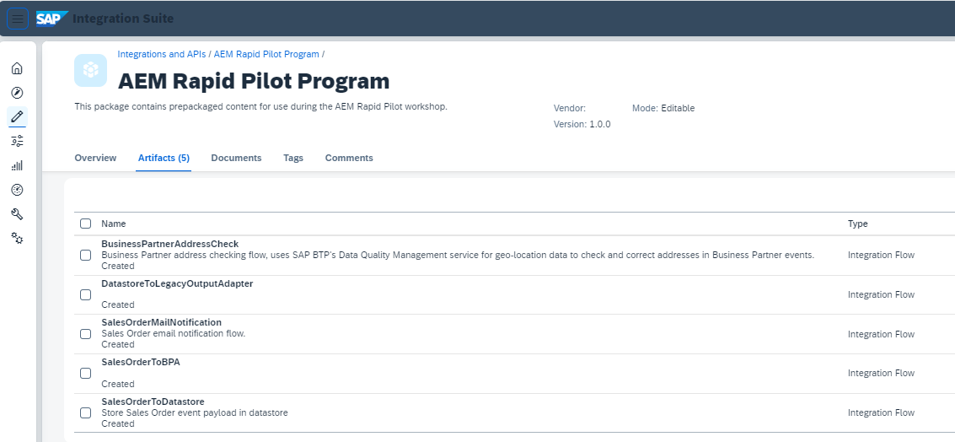
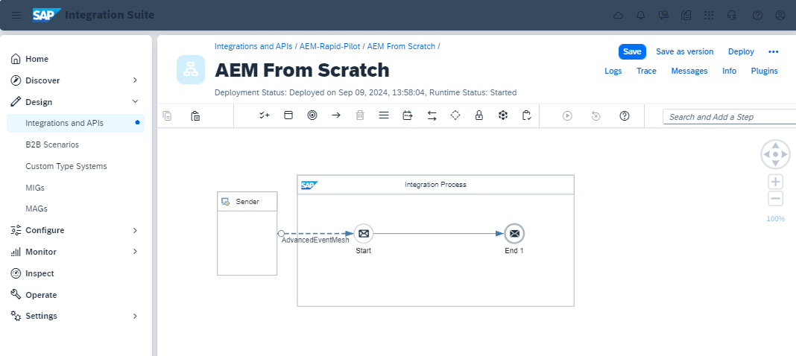
Scenario Cloud Integration
Pre-packaged content covering
First connectivity Create your own IFlow and learn how to connect it to the SAP Advanced Event Mesh via the AEM Adapter using the SMF protocol
Dead Message Queues Learn how to configure and handle retries and error behaviors

Slide 42
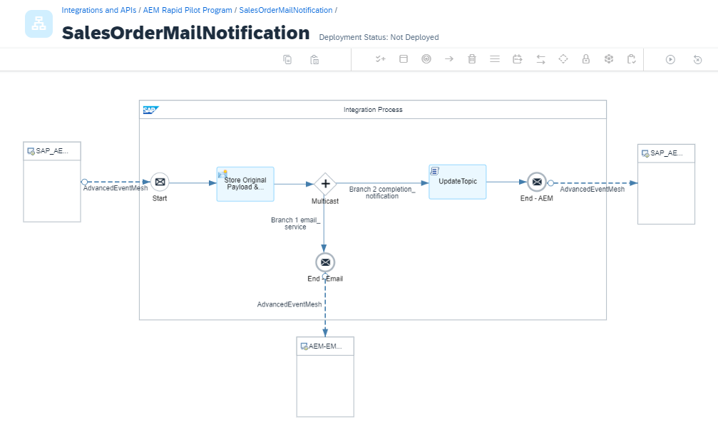
Scenario Cloud Integration
Mail Notification Flow Connect your events to a basic notification service via E-Mail

Slide 43
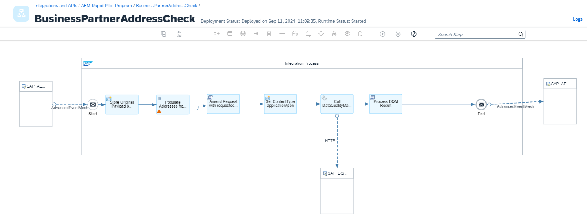
Scenario Cloud Integration
SAP Data Quality Management Integrate with SAP DQM to cleanse address data in BusinessPartner events

Slide 44
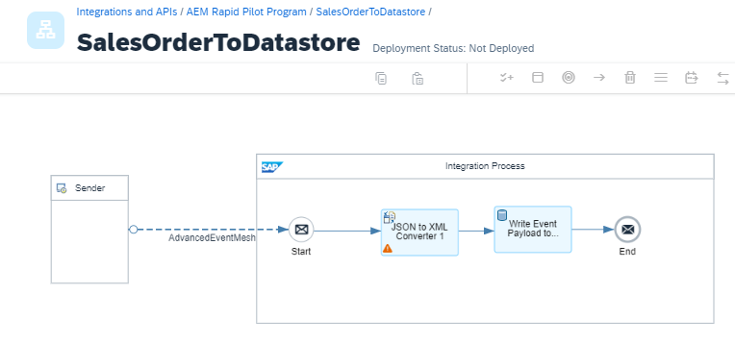
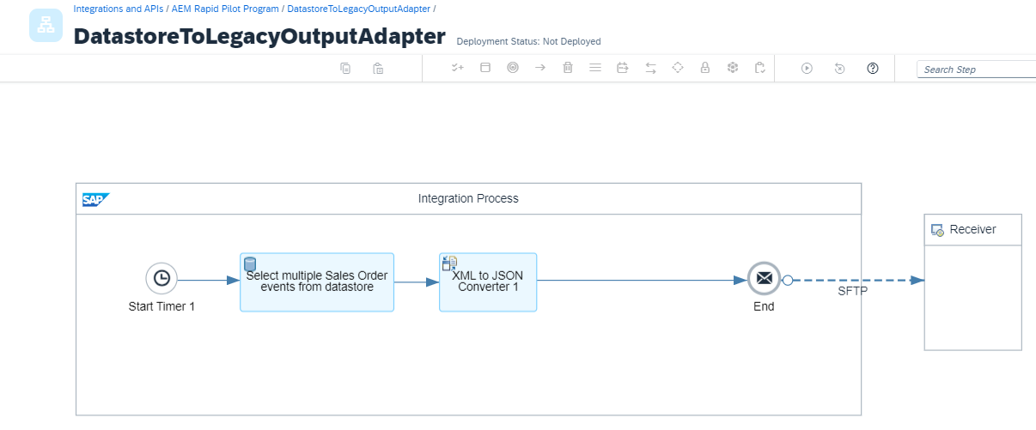
Scenario Cloud Integration
File-based integration via SFTP Leverage Integration Suite to enable legacy integrations by batching events in the Cloud Integration Data Store

Slide 45












SAP Build Process Automation Automate processes and tasks with drag-and-drop-simplicity
Enterprise Automation
Fusion team
development
SAP Build Process Automation
SAP and non-SAP integration
SAP Integration Suite
Processes and
workflows
Forms and
multistep approvals
Task
automation
Unified launchpad
and task center
Low-code
app dev and
business sites
SAP Build
Business process insights and transformation
SAP Signavio
Business rules
and decisions
Prebuilt
content
Document
understanding
Process visibility
and flexibility
Pro-code app dev
SAP Build Code
430+ prebuilt
processes and automations

Slide 46
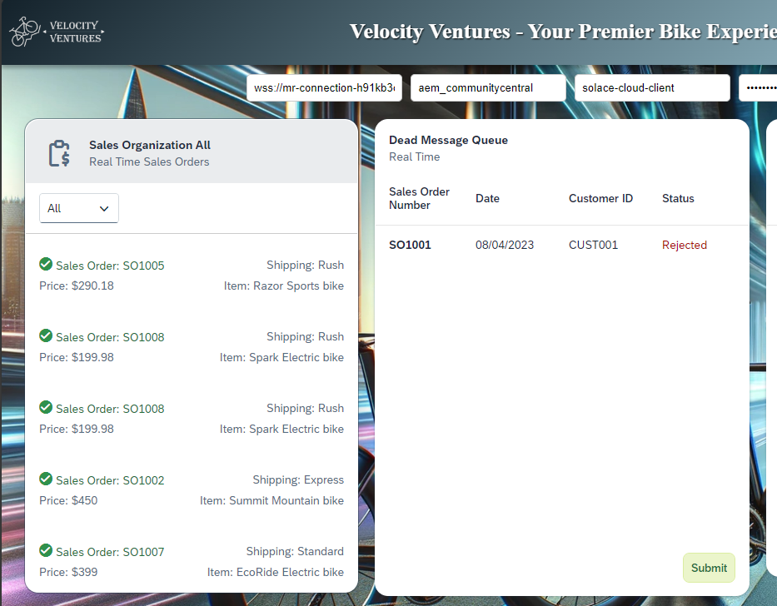
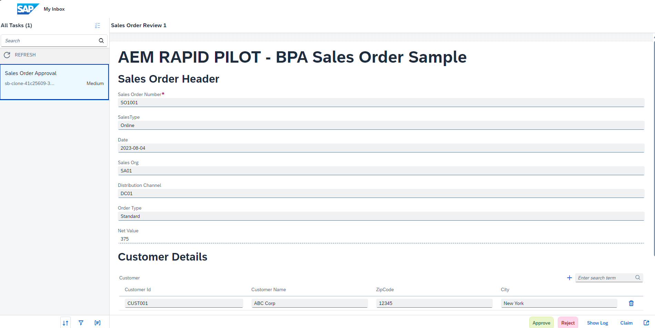
Scenario BPA
Pre-packaged content for Build Process Automation to handle the approval/rejection of failed SalesOrders from the users Inbox

Slide 47
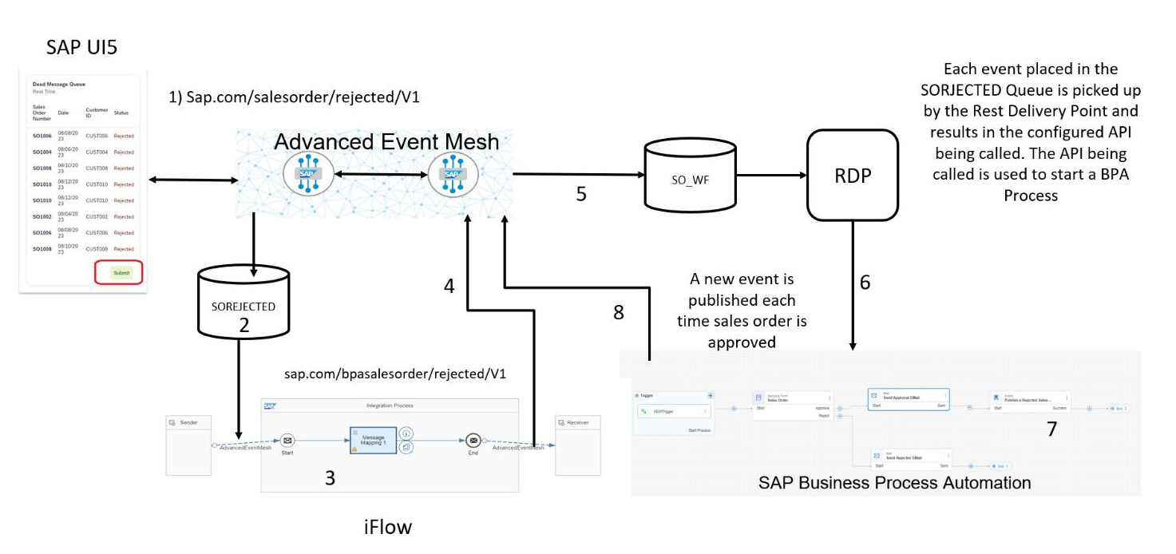
Scenario BPA

Slide 48
Prerequisites
What you will need for today:
Access to the same AEM cloud console and broker you setup on Day 1
Access to the event simulator from Day 1
Access to an active SAP Integration Suite tenant
Access to an active SAP Build Process Automation instance
Nice to have:
An active SAP Data Quality Management instance and service key
Access to an SFTP server

Slide 49


Exercise Flow Digital Integration Hub Topic 3 1.Create queues/topic subscriptions in AEM 2. Create consumer IFlows in Integration Suite 3. Automation configuration of AEM using API (optional) 4. Connect Process Automation 5. Test and review with events
Public Cloud Apps I Data I Users | Things
Desktop
SAP Business Technology Platform
Event Simulator
5
Advanced Event Mesh
3
1
4
Process Automation
Pub / Sub
Cloud Integration
2
SAP IAS
On-Premise Integration Components
Firewall
DMZ
Firewall
Firewall
On Premise Apps I Data I Users | Things
S/4HANA

Slide 50
Topic 4 - Agenda
Event Management
Event Portal
Event Approval Process
Event Insights
Monitoring
Distributed Tracing
Advanced Event Mesh – API’s

Slide 51
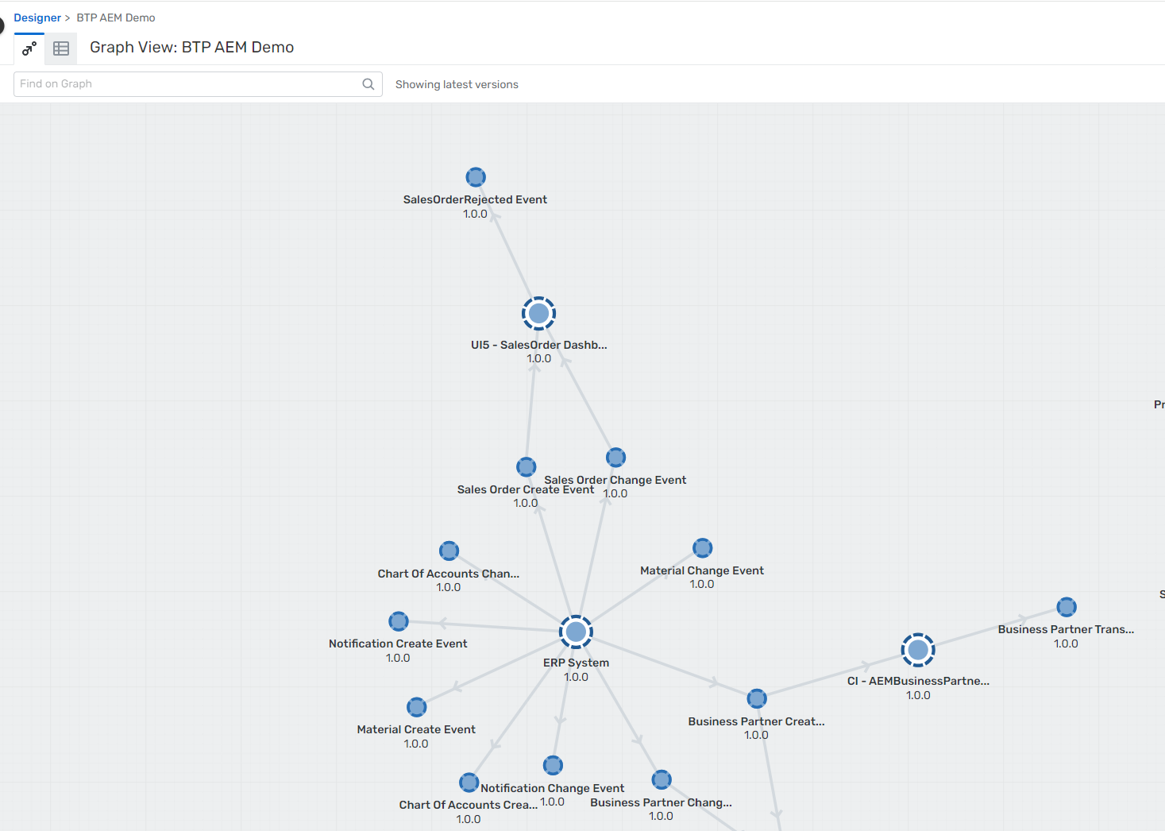
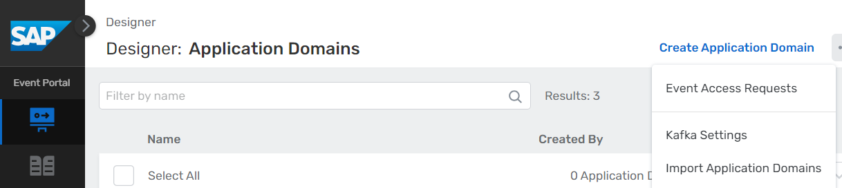
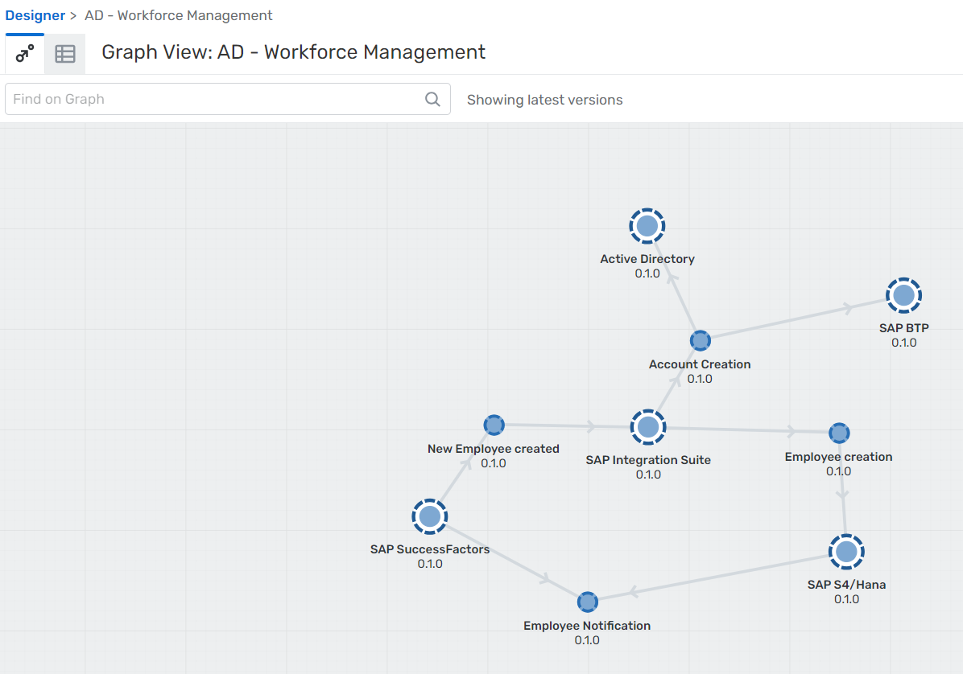
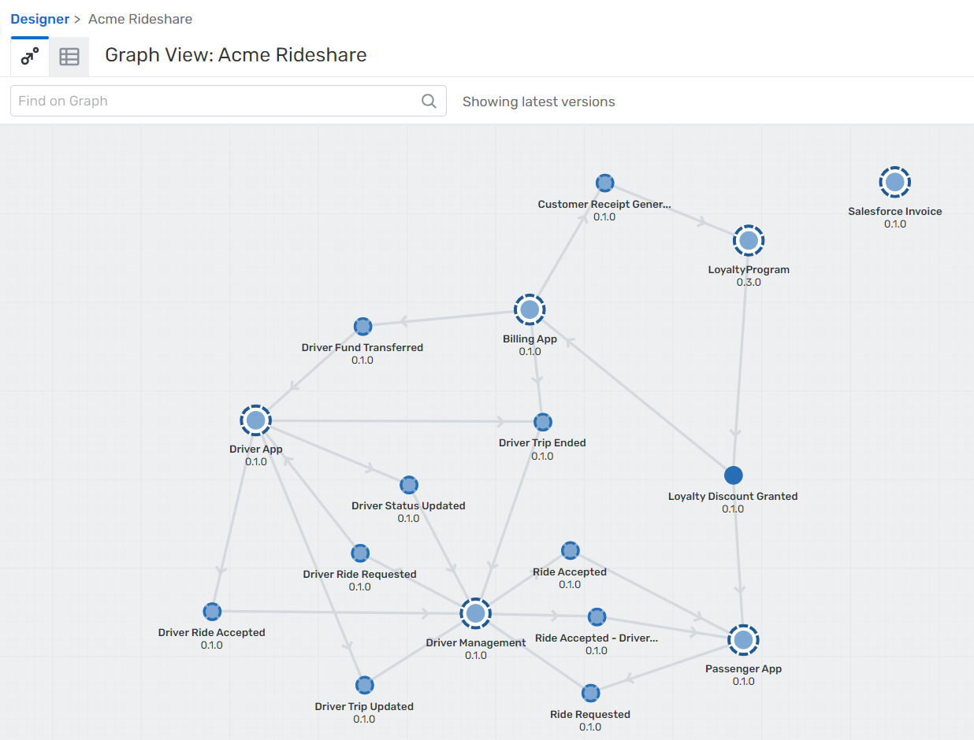
Event Management - Event Portal
Discover pre configured Application Domains (Import the json content)

Slide 52
Event Management - Event Portal
Discover pre configured Application Domains (Import the json content)

Slide 53
Event Management - Event Portal
Discover pre configured Application Domains (Import the json content)

Slide 54
Event Management - Event Portal
Discover pre configured Application Domains (Import the json content)

Slide 55
Event Management - Event Portal
Discover pre configured Application Domains (Import the json content)

Slide 56
Event Management - Event Portal
Type | Function
Application Domains | Application domains organize your applications, events, and other associated objects for different teams, groups, or lines of business within your organization.
Applications | An application in Event Portal is an object that represents software that produces and consumes events
Events | Event is an object that defines the properties that describe and categorize actual event instances. Events represent formally messages that applications publish for every event happing in real time (e.g. state change, field change, button click etc.)
Schemas | A schema defines the payload of an event. Most of the Events and Messages arr JSON, XML or csv related payloads.
Enumerations | A limited set of acceptable values – predefined. Use enumerations to define values for a level in a topic address or topic domain (e.g. country codes)

Slide 57
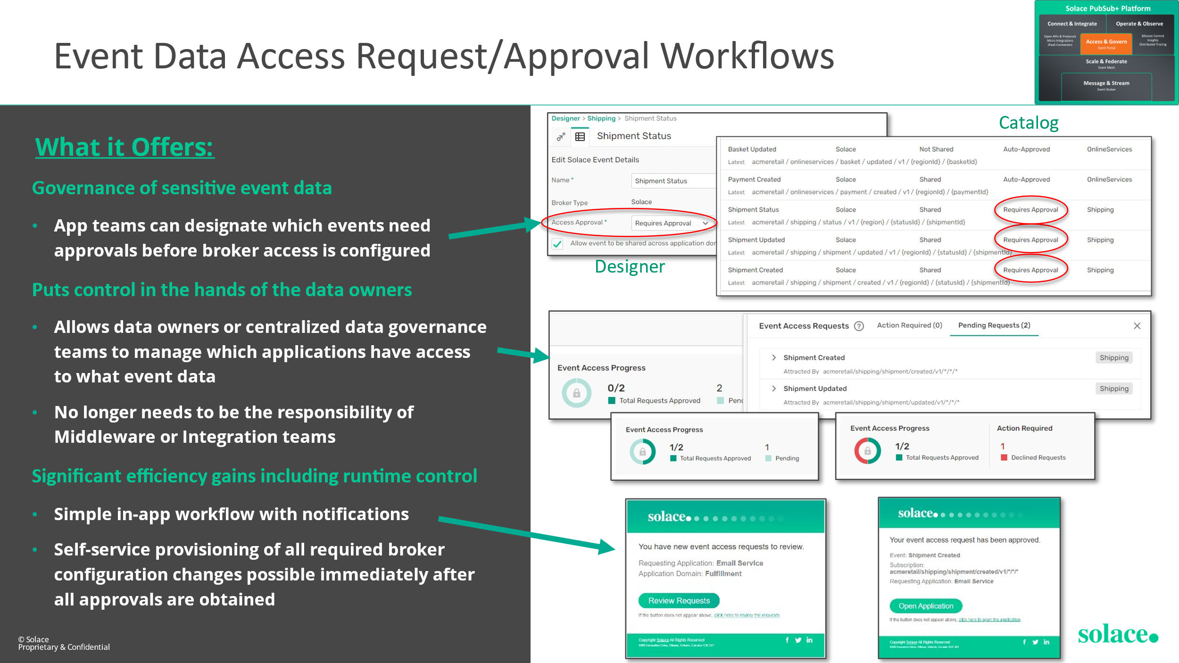
Event Management – Event Approval Process

Slide 58
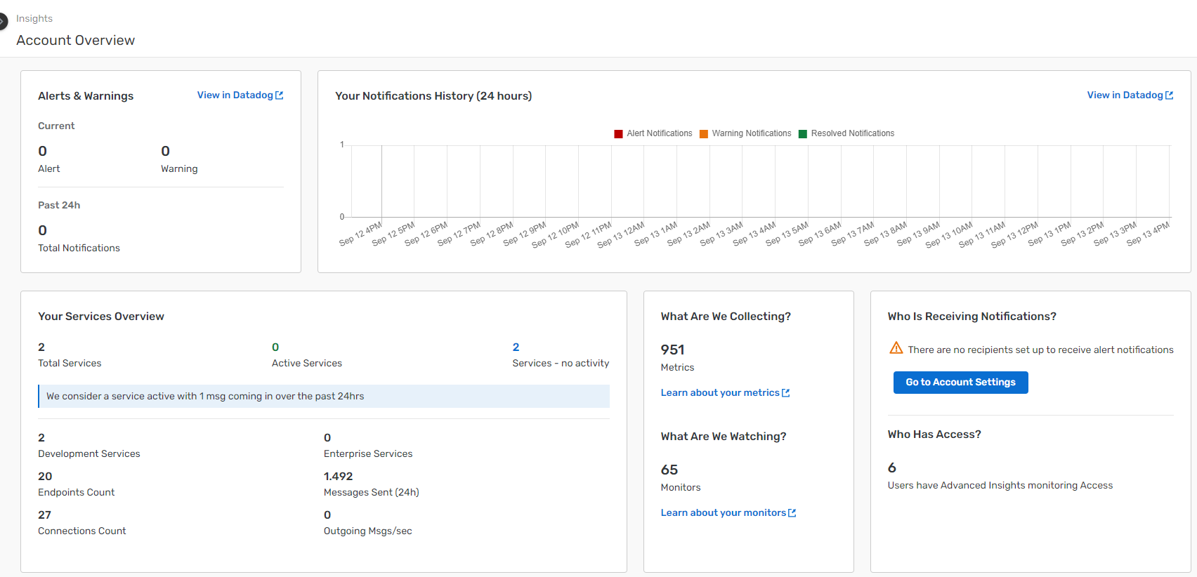
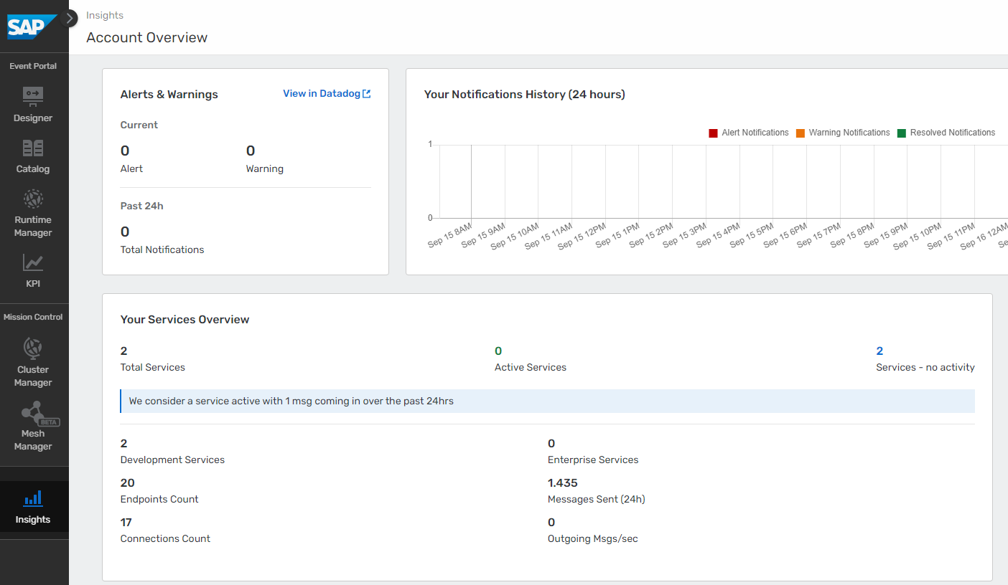
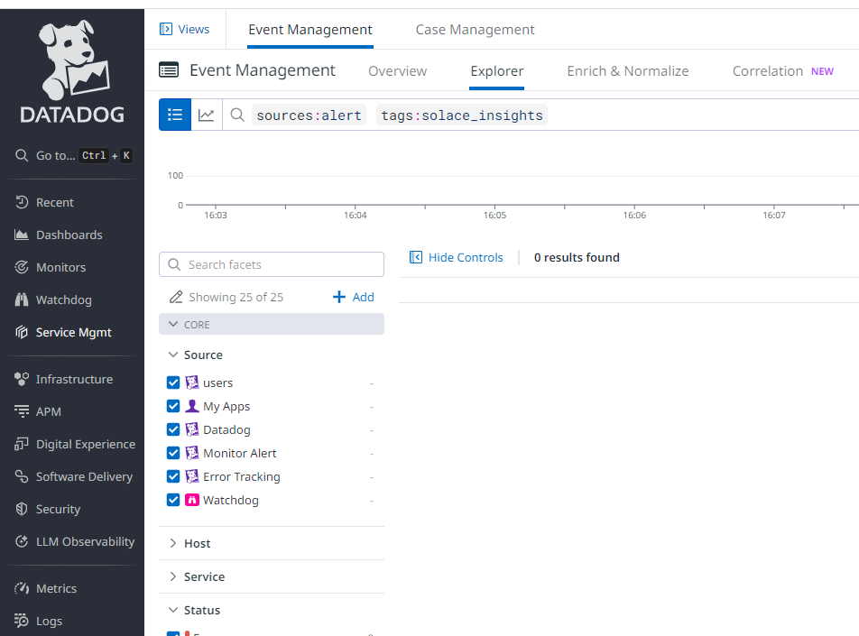
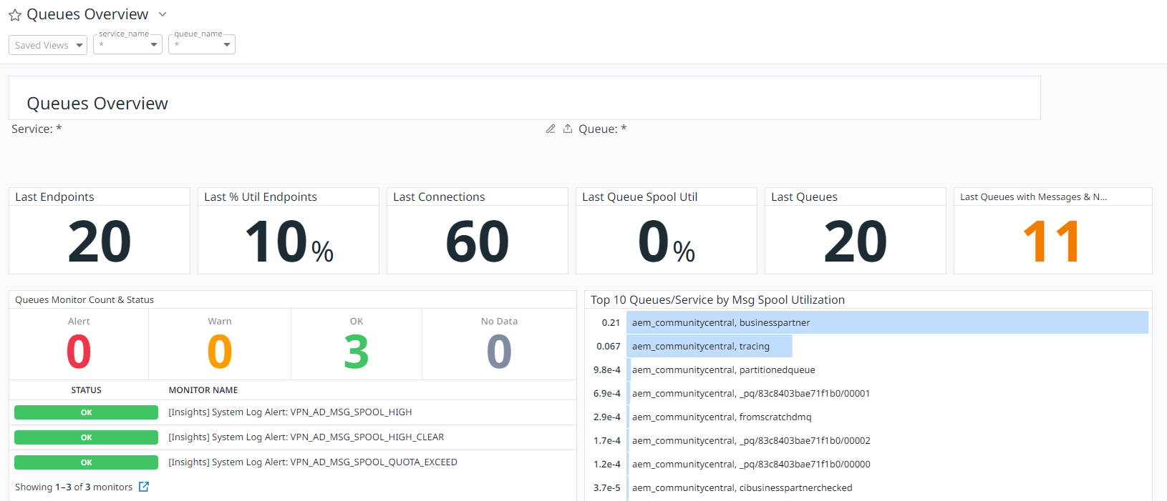
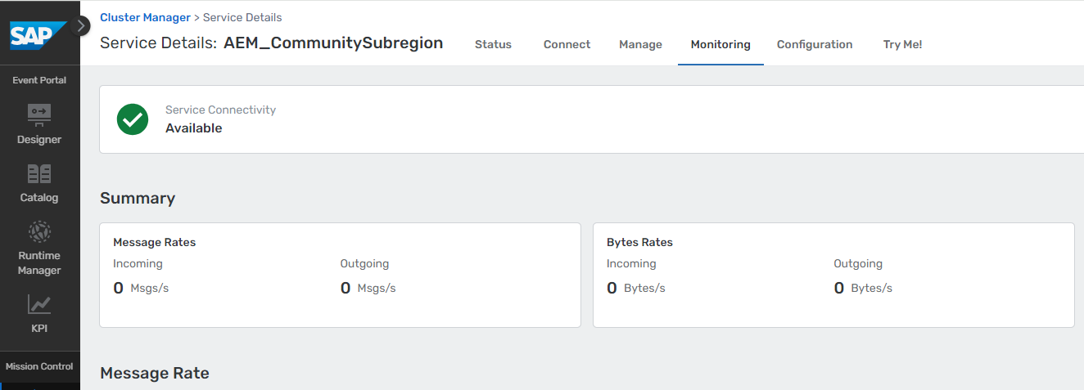
Event Insights - Monitoring
Notes:
JMSToolbox

Slide 59
Event Insights - Monitoring

Slide 60
Event Insights - Monitoring

Slide 61
Event Insights - Monitoring

Slide 62
Event Insights - Monitoring

Slide 63
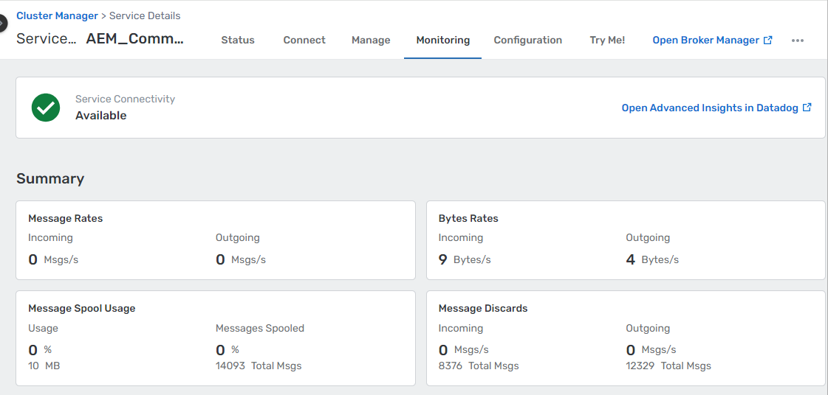
Event Insights - Monitoring

Slide 64
Event Insights - Monitoring

Slide 65
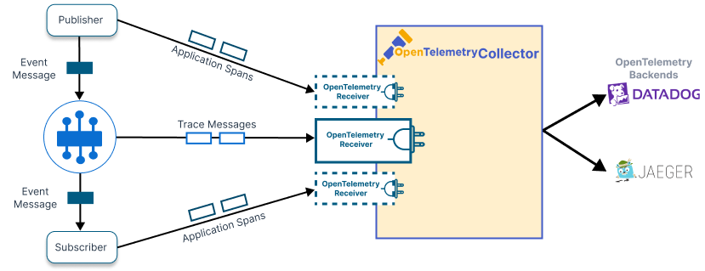
Event Insights - Distributed Tracing
Intention:
Applications in large organizations consist of hundreds or thousands of services.
These services run across many hosts and share messages over one or more event meshes.
Diagnosing problems by troubleshooting error messages or logs is no longer feasible.
A solution is needed to track an event from the sending application, through event brokers, to the receiving application
Approach:
the event broker generates special guaranteed messages when certain operations happen
the publisher and subscriber APIs also generate spans when messages are sent and received
OpenTelemetry receivers consume these messages from a particular queue and convert to a format that can be received, processed, and viewed using DataDog.
Conclusion: Distributed tracing …
… allows tracking the lifecycle of an event as it moves through the event mesh.
… helps diagnosing issues by providing visibility into the event flow across different services and brokers.
… enables monitoring of performance metrics and identifying bottlenecks in the event processing pipeline.
… Improves overall observability of the system by correlating events and tracing their paths end-to-end.

Slide 66
Event Insights - Distributed Tracing
Approach:
the event broker generates special guaranteed messages when certain operations happen
the publisher and subscriber APIs also generate spans when messages are sent and received
OpenTelemetry receivers consume these messages from a particular queue and convert to a format that can be received, processed, and viewed using DataDog.

Slide 67
Event Insights - Distributed Tracing
Intention:
Applications in large organizations consist of hundreds or thousands of services.
These services run across many hosts and share messages over one or more event meshes.
Diagnosing problems by troubleshooting error messages or logs is no longer feasible.
A solution is needed to track an event from the sending application, through event brokers, to the receiving application
Approach:
the event broker generates special guaranteed messages when certain operations happen
the publisher and subscriber APIs also generate spans when messages are sent and received
OpenTelemetry receivers consume these messages from a particular queue and convert to a format that can be received, processed, and viewed using DataDog.
Conclusion: Distributed tracing …
… allows tracking the lifecycle of an event as it moves through the event mesh.
… helps diagnosing issues by providing visibility into the event flow across different services and brokers.
… enables monitoring of performance metrics and identifying bottlenecks in the event processing pipeline.
… Improves overall observability of the system by correlating events and tracing their paths end-to-end.

Slide 68
Advanced Event Mesh – API’s
API Overview
Manage SAP Advanced Event Mesh
Manage SAP Event Brokers
Connection & Protocols
SAP Advanced Event Mesh - REST – API(v2) (PubSub+ Cloud REST API)
Managing Services
Configuration Reference
SEMP(v2) (Solace Element Management Protocol)
Configuration Reference
Action Reference
Monitor Reference
Open API‘s & Protocols
API‘s
Open Wireline Protocols

Slide 69
Overview
SAP Advanced Event Mesh - REST – API(v2)
In a nutshell: „Administration of the Cloud Env. of Advanced Event Mesh
This API provide mechanism for you to manage event broker services, work with Event Portal and manage accounts for advanced event mesh
Legacy v0/v1 available – not recommended to use
For further documentation also known as: PubSub+ Cloud REST API
SAP Advanced Event Mesh - SEMP(v2) (Solace Element Management Protocol)
In a nutshell: “Admin interface for the brokers”
This Rest based API can be used for provision, operate, and maintain a single SAP Event Broker
Open APIs
JMS (Java Message Service): allowing seamless integration with Java-based applications
Open MAMA: Open Middleware Agnostic Messaging API (OpenMAMA) open-source, lightweight, vendor-neutral integration layer for sending and receiving market data information
REST: REST Messaging API enables HTTP clients to send and receive messages with an event broker
Supported Protocols
AMQP (Advanced Message Queuing Protocol) 1.0
MQTT (support for MQTT 3.1.1 and MQTT 5.0 standards)
WebSocket - Protocol
Support of Terraform
https://github.com/SolaceProducts/terraform-provider-solacebroker
https://docs.solace.com/Admin/SEMP/Declarative-SEMP.htm
Notes:
Further Reading:
Rest API AEM:
https://docs.solace.com/Cloud/cloud-rest-api-lp.htm
https://help.pubsub.em.services.cloud.sap/Cloud/cloud_rest_api.htm

Slide 70
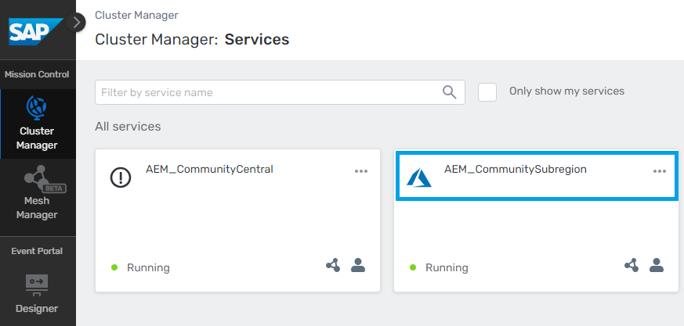
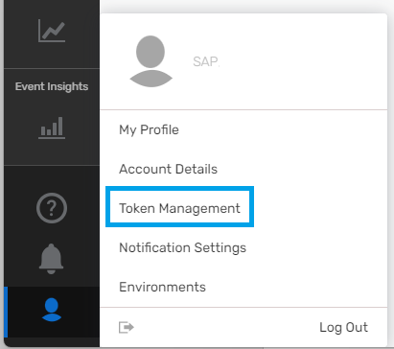
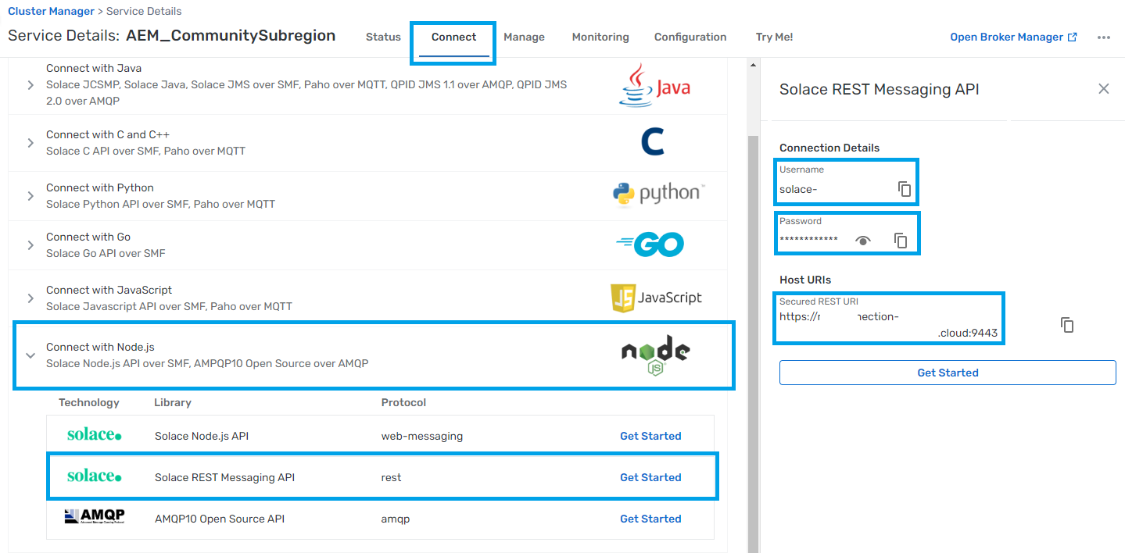
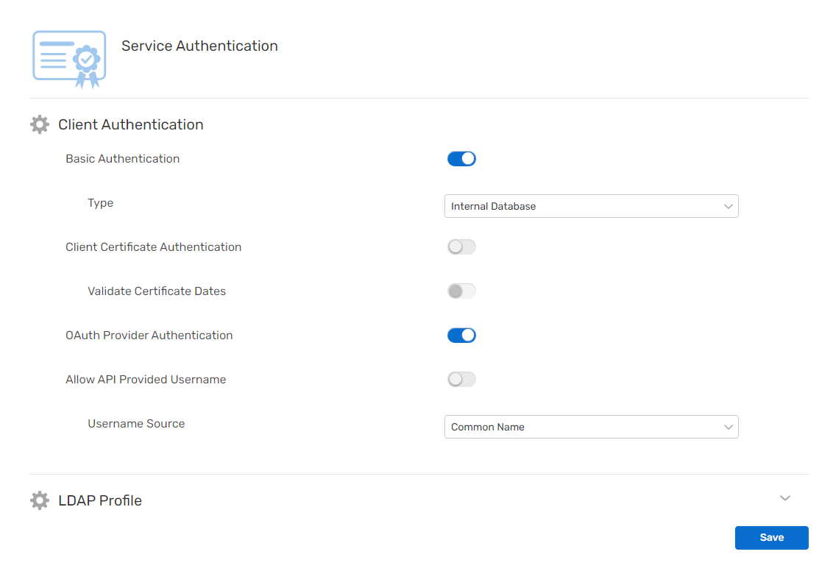
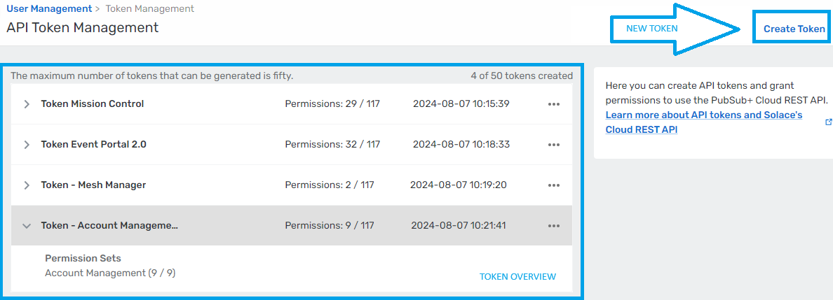
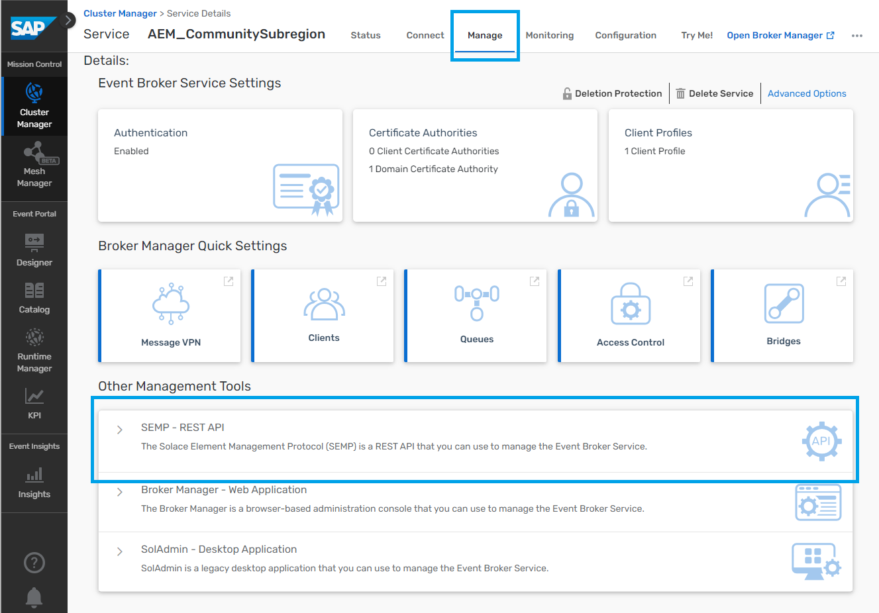
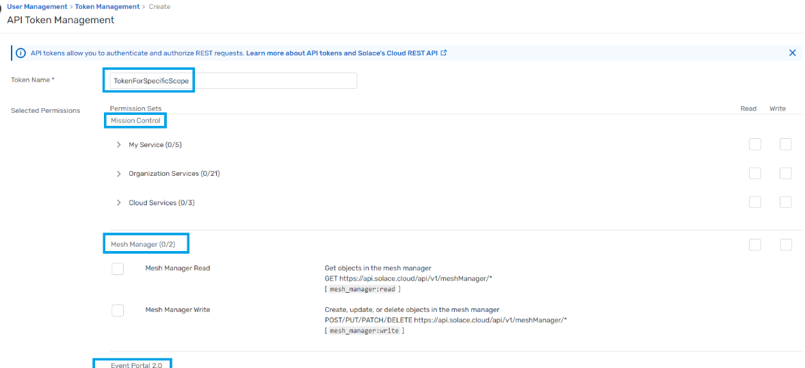
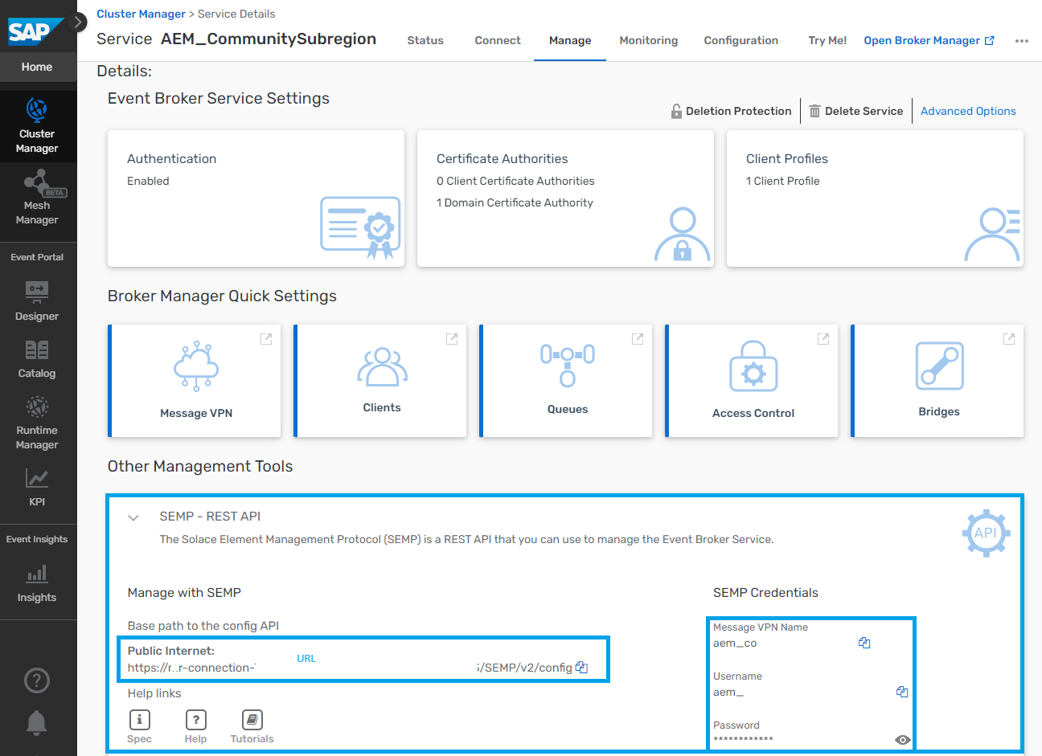
Manage AEM API Access
REST – API(v2)
SEMPv2
Open APIs – e.g. REST
create up to 50 API tokens (per user) in an account
setup a proper authorization management, assign granular specific scopes and permissions for specific topics (Mission Control, Event Portal etc.)
Source: identify the login / cloud URL: https://help.pubsub.em.services.cloud.sap/Cloud/cloud-login-urls.htm

Slide 71
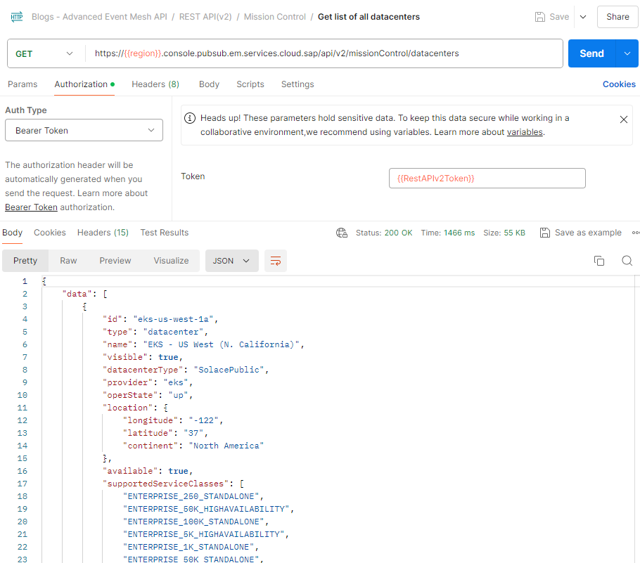
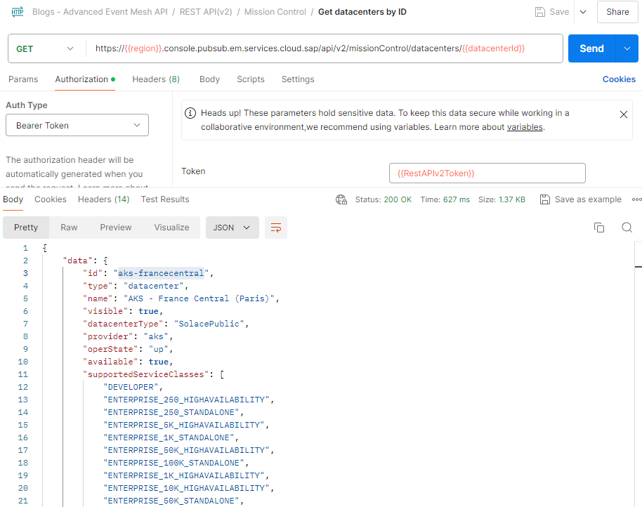
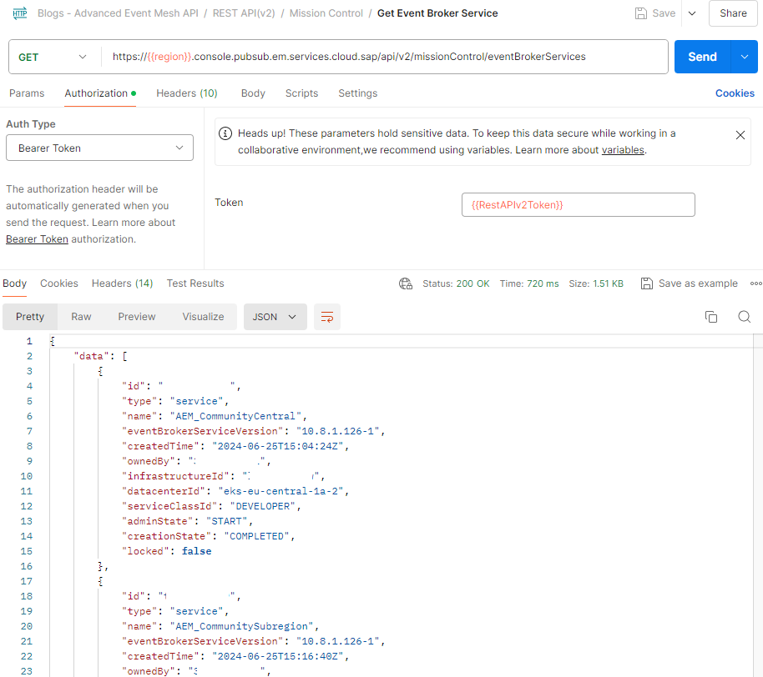
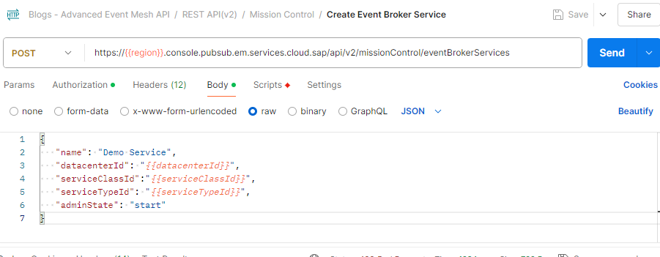
SAP Advanced Event Mesh REST – API
v1/v0 — Legacy versions of the REST APIs
v2— the current (and more modern) v2 REST APIs (focused on)
GET BASE URL
Set up on a per-region basis using the following format: https://<region>.console.pubsub.em.services.cloud.sap?xyz →
Example: Region eu10 → https://eu10.console.sap.pubsub.em.services.cloud.sap
Full API Reference: REST API(v2) Reference
Function | Example
Get list of all datacenters
Get datacenters by ID
Get Event Broker Services
Create Event Broker Service
Source: identify the login / Cloud URL: https://help.pubsub.em.services.cloud.sap/Cloud/cloud-login-urls.htm
Notes:
API Dokumentation: https://api.solace.dev/cloud/reference/using-the-v2-rest-apis-for-pubsub-cloud

Slide 72
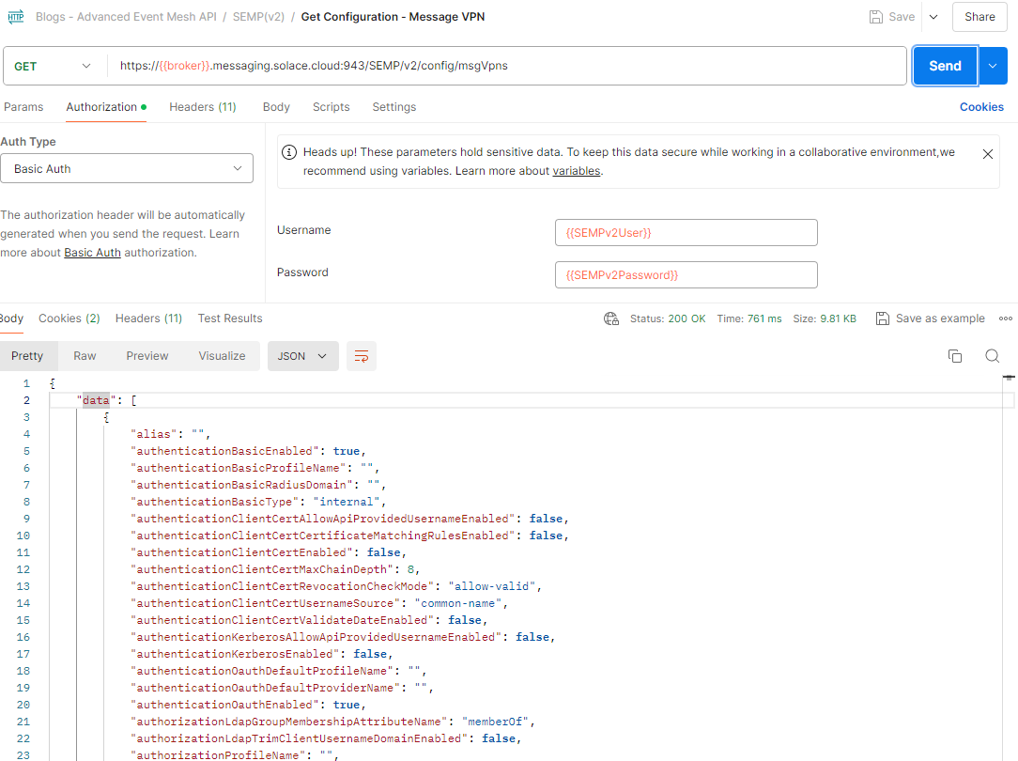
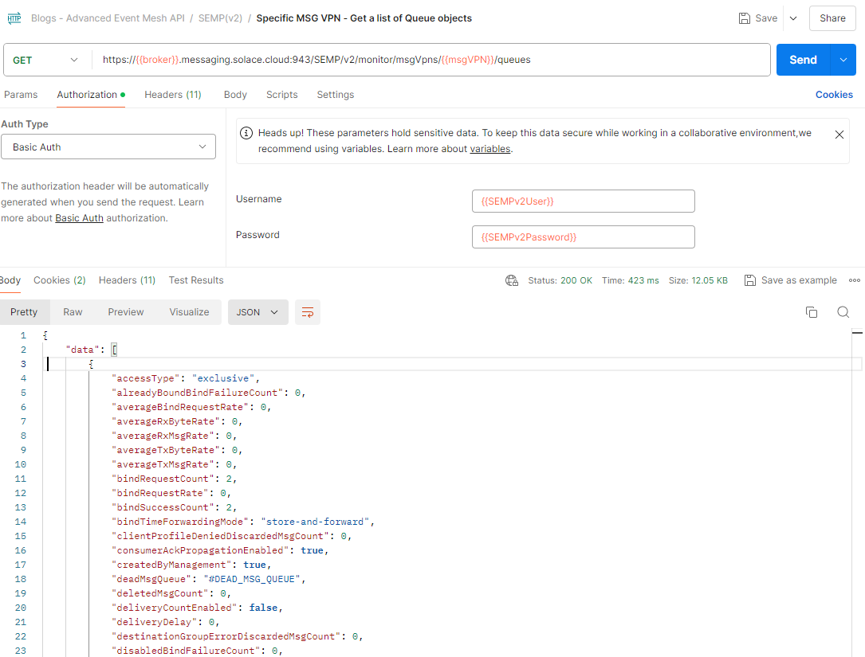
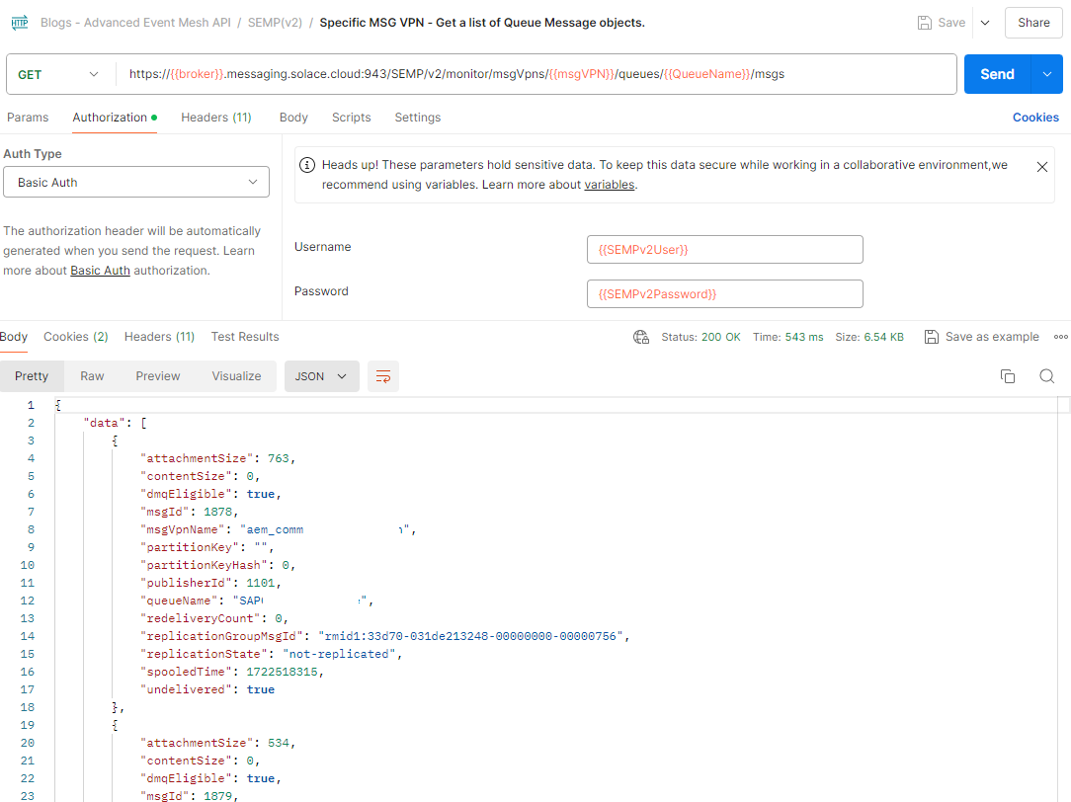
SEMP(v2)
This Rest based API can be used for provision, operate, and maintain a single SAP Event Broker
Full API Reference:
Configuration Reference
Action Reference
Monitor Reference
Function | Example
Get a list of Message VPN objects
Get a list of Queue objects
Get a list of Queue Message objects

Slide 73
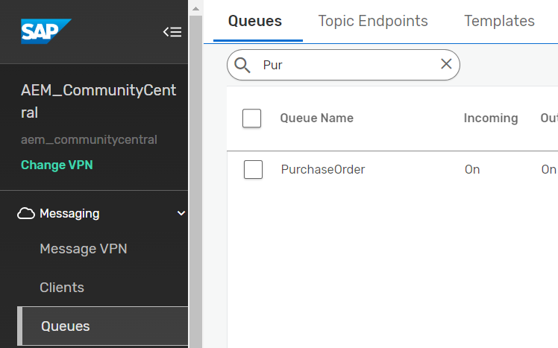



Open APIs - REST
REST Messaging API enables HTTP clients to send and receive messages with an event broker
No explicit example - Referring to the demo and configuration steps: Publish / Subscribe with REST

Slide 74
Topic 5 – AIF
Application Interface Framework (AIF)
Introduction
Demo
Exercise
Notes:
Feedback so far?

Slide 75

Application Interface Framework (AIF)

Slide 76

Application Interface Framework (AIF)
SAP Application Interface Framework enables you to develop and monitor interfaces as well as execute error handling in a single framework residing in your SAP back end system.
It is based on SAP NetWeaver technology and can therefore work for legacy systems as well. On S/4HANA it is preinstalled, on ECC Systems it can be installed as AddOn
AIF allows specifically:
To use a powerful framework for the implementation of interfaces and the logic behind
To monitor interfaces with different interface technologies (e.g. Idocs, ABAP Proxies)
This works for both SAP ECC and SAP S/4HANA backends
SAP is delivering standard interfaces on AIF
Customers can build their own interfaces*
* requires AIF_GEN module and license

Slide 77


AIF Features
For business users:
Automatic alerts that notify business users to errors
User-friendly transactions for interface monitoring, error handling, and the correction of errors directly from within the application system
Both SAP GUI and Web-based user interfaces
Use of a single tool for monitoring and handling of messages regardless of the interface technology involved
For IT personnel:
A powerful framework for the implementation of interfaces
A customizable interface framework for the generation and reuse of interface building blocks over multiple interfaces
Flexible authorization rules to restrict access to data and to monitoring and error handling
Tools for system configuration and operation
Monitors interfaces with different interface technologies, for example, ABAP proxies and IDocs
* requires AIF_GEN module and license

Slide 78

AIFAEM

Slide 79

AIFAEM
SAP Integration Suite, advanced event mesh is SAP’s main event broker/mesh offering.
Newer SAP backends like SAP S/4HANA come with built in, standard event enablement approaches.
Older backends like SAP ECC lack out of the box event enablement support.
AIF is being used by thousands of SAP customers as of today
To allow for older SAP backends to expose events, SAP AIF is a natural choice.
Using the new AIFAEM software component of AIF, custom events can be created to be exposed via SAP Integration Suite, advanced event mesh from both SAP ECC and SAP S/4HANA systems.

Slide 80

AIFAEM in Detail
AIFAEM allows to utilize AIF and its capabilities to publish custom events via AIF to SAP Integration Suite, advanced event mesh for processing and monitoring
AIFAEM is composed of two components:
AIFAEM which mirrors the license within the ABAP system
AEM Extension of AIF for the integration with SAP Integration Suite, advanced event mesh

Slide 81

AIFAEM Features
Creation of custom events based on the BOR framework for SAP backends including SAP S/4HANA and SAP ECC
Support of CloudEvents format
Sophisticated structure mapping
Event connectivity to SAP Integration Suite, advanced event mesh
Monitoring and Error Handling Integration
Transaction /AIF/ERR
SAP Fiori Message Monitoring App

Slide 82

AIFAEM: Supported Releases
Supported releases for AIFAEM are:
SAP NW 7.31 (ECC)
SAP NW 7.55 (S/4 HANA 2020) and following
AIFAEM is delivered as ABAP Add-On downloadable by customers
AIFAEM731: for SAP NW 7.31
AIFAEM800: for SAP NW 7.55, and subsequent releases
AIFAEM does not need AIFGEN as a prerequisite. Both modules work seamlessly in single installation.

Slide 83

AIFAEM: Commercials
AIFAEM usage right is included with your SAP Integration Suite, advanced event mesh entitlement
There is no additional charge for AIFAEM usage (i.e. events do not count into AIF message quota)

Slide 84
Additional Information on AIFAEM
Blog on AIFAEM: A Natural Choice: SAP AIF can now expose events
Blog on AIF: SAP Application Interface Framework: All you need to know
Blogs creating an AIF based event:
How to integrate SAP S/4HANA BOR Framework with SAP Integration Suite, advanced event mesh using AIF
How to set up enhanced SAP Events for Advanced Event Mesh with Application Interface Framework
Note on AIFAEM: Note on AIFAEM

Slide 85
SAP Application Interface Framework Product Overview – SAP AIF Usage Scenario: AIFAEM
Reusable interface building blocks
Processing Sequence within AIFEM Runtime (outbound, schematic):
Application Interface Framework
Interface Determination
Structure Mapping
Source Struct. → Dest. Struct. → Field Mappings (w/ Conditions)
Actions
SAP AEM
Preparation
Raw Data Structure
SAP Data Structure
Value Mappings
Fixed Values
Checks
Queue
Queue
Queue
AIF Enabler
Index Tables
Statistics
Application Engine
Selection Engine
Persistence Engine
Logging Engine
Standard Content
AIFAEM Add-On
BOR Linkage Function Module
/AIF/TRANSFER_TO_AIF_RECEIVER
Generic RAW Structure
/AIF/EVENT_RAW
Value Mapping Functions
/AIF/AEM_GET_ID,
/AIF/AEM_GET_SOURCE,
/AIF/AEM_GET_TIME
Name Mapping Table
/AIF/NAME_MAP
Action Function Module
/AIF/AIF_ACTION_CALL_AEM
Install AIFAEM Add-On
Setup SM59 connection to SAP AEM
Define naming convention
Receiver Concept
Create AEM namespace
Link BOR Event (SWE2) to AIF
Define Interface Determination
Create an interface with at least:
Interface name
Interface version
RAW structure SAP structure
Create strucure mappings:
Source <> Target
Assign AEM Destination as Fixed Value
Value Mapping
Assign Checks
Maintain XML Engine as Application Engine
Maintain the provided AIFAEM action
Test Event
Check AIF Monitoring & Alerting
Activities

Slide 86



Exercise Flow Digital Integration Hub Topic 5 - AIF
Public Cloud Apps I Data I Users | Things
Desktop
SAP Business Technology Platform
Event Simulator
5
Advanced Event Mesh
BOR Framework
3
1
4
Process Automation
How? AIFAEM Standard Function Module
What? Type (e.g. Sales Order), ID (001) and Event (created)
Pub / Sub
Cloud Integration
Application Interface Framework (AIF)
2
SAP IAS
How? AIFAEM Standard Function Module
Self-designed ABAP Structure customized into AIF & converted to JSON
On-Premise Integration Components
Firewall
DMZ
HTTP Destination (SM59)
On Premise Apps I Data I Users | Things
S/4HANA

Slide 87


Topic 5 – Expected Result on Event Publisher
Change of SalesOrder (VA02)
AIF Monitoring (/N/AIF/ERR)

Slide 88

Topic 5 – Expected Result on AEM
TryMe – Functionality on AEM

Slide 89

Topic 5 – AIF: Expected Result on Dashboard

Slide 90









Learn more!
Blogs Getting You Started
Technical Resources
Learning Opportunities
SAP’s Event-Driven Ecosystem
Discovery Center
Embrace Event-Driven Architecture with SAP Integration Suite
Introducing Advanced Event Mesh
Road map
TechEd: Deep dive into AEM
Documentation
Devtoberfest: SAP S/4HANA and Advanced Event Mesh
SAP S/4HANA integration with AEM

Slide 91
Questions/Feedback?

